Slide 1
Call Center Business Case
Overview for Sales Team
June 2013

Slide 2
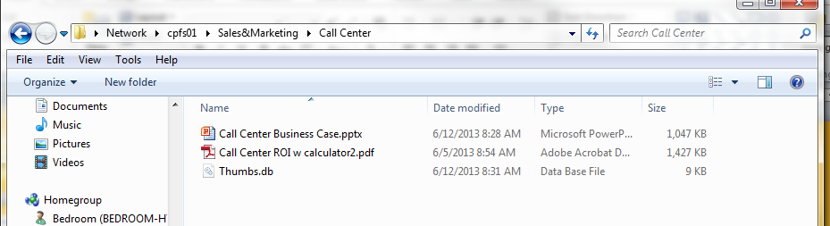
Where to Find Call Center Materials
\\cpfs01\Sales&Marketing\Call Center
PDF version with calculator
  Call Center ROI w calculator2.pdf
Powerpoint Guide for Sales
  Call Center Business Case.pptx
  Do not send to customers without reviewing, editing!!!

Slide 3
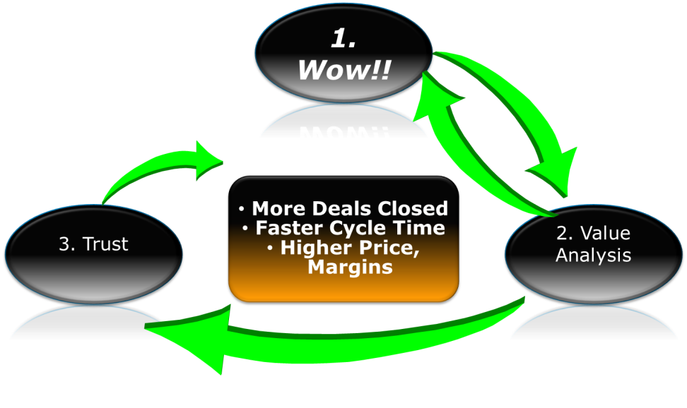
Selling with ROI Tools
Wow! Capture customers attention
State and reinforce Bria’s value proposition
Start discussion with customer about their challenges, goals and assumptions
  Learn more about their operations
  Learn what they know, don’t know
Illustrate the value proposition in financial or operational terms
3. Let the customer perform analysis based on their assumptions
  We just provide tool and guidance
  They mentally own, trust the analysis
Use discussion and analysis to frame negotiations in our favor
Fitting ROI Value Analysis into Sales Cycle

Slide 4
Benefits of Deploying Bria in Call Center
Delivers reliable, high-quality voice experience for crystal-clear communications with customers
Provides an efficient, locked-down user interface (UI) that enables third-party call control to achieve high agent productivity
Lowers upfront investment by using softphones instead of desksets
Provides future-proofed investment via softphone software’s upgrade path
Integrates with existing and future call center infrastructure (IP-PBX, ACD, CRM, Messaging, Video)
Transitions the call center to a multi-channel contact center (voice, chat, video)
Simplifies provisioning and maintenance for both in-center and out-of-center workers
Enables distance working and disaster recovery scenarios

Slide 5
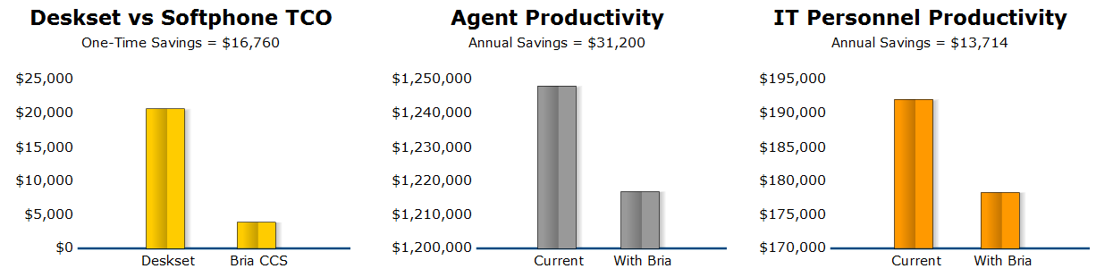
Bria’s 3 Areas of Impact on Call Centers
Assumptions
High quality deskset = $200
Bria list pricing based on # of seats ($49 to under $20)
No additional headset costs
Branding = $6,000
CCS = $30,000
Assumptions
Higher productivity from:
  Voice quality
  3rd party call control
  Locked and minimized UI
  Faster disaster recovery
Customer feedback from operations = at least 3% savings
Agent wages = $15/hour
Assumptions
IT Admin = $50/hour loaded wages
CCS
  saves time and wages spent on provisioning /MACs vs. desksets
  enables time to be focused on more valuable, strategic issues

Slide 6



Real-World Productivity Improvements
Five 9’s: 25,000 clients
  Using SDK
  Integrated into ACD for 3rd party call control
InContact: 38,000 clients
  See case study
  Clients seeing benefits from cloud operations
  Higher reliability and ability to address disaster relocations faster
BT Harrier: 10,000 seats
  Over 5% distance workers
  Rated highest in quality and productivity
  3rd party call control: 2 seconds before next call is pushed, auto answered
  Hiding softphone in system tray

Slide 7
What Drives Agent Productivity
Bria Feature | Impact
High voice quality | Better communication with customer = shorter calls Lower Mean Time to Handle
3rd party call control | Integrates with ACD, CRM Pushes call when agent and customer information is available Reduces agents ability to pause Shorter mean time to answer More calls answered, lower cost per call
Locked-down, minimized softphone UI | No deskset equipment to distract agent from screen System tray UI stays out of agent’s way Locked-down = no outages
Mobile client, simple provisioning | Faster time to relocate, recover from disaster Shorter outage, higher availability

Slide 8
Questions for Your Customers
Do you have Centrex or TDM PBX platform today? Are you moving to IP-PBX soon?
How many call centers to you have?
How many seats total? Do you have multiple shifts? How many are distance-workers, home workers?
What are you paying for VoIP desksets? What sort of quality are you getting? Can you monitor voice quality?
How many break, need replacement per year?
What is your average agent wage?
If IP-PBX, do you have auto-answer and 3rd party call control?
Do you have disaster recovery plans?
How many on your IT staff are involved in provisioning, maintaining, move-add-change of desksets?
What is the loaded hourly wage of your IT staff person?

Slide 9

Potential Problems
Small call centers
  Smaller centers (under 20) have difficult time justifying upfront expenses
  Solution: Branding, customization and CCS can be removed from upfront costs
Agent Productivity
  The minimum productivity improvement we allow is 2%
  If they do not believe there are productivity improvements, then you are not selling hard enough ;)
  Solution: We could run a separate ROI without
IT Productivity
  This improves assumes CCS purchase
  Solution: If they don’t believe the productivity improvement, we can run a separate ROI without

Slide 10
Next Steps
Place Call Center ROI Tool online
  Save, retrieve scenarios
  Generate customized URL with scenarios embedded in text

Slide 11
Bria Features for Call Centers
(from Bruce Ford)

Slide 12
Introduction
CounterPath’s Bria for Windows desktop client is widely deployed in Call Centers
  Best-in-class soft phone that replaces costly hard phones
Proven interoperability with market leading Call Center solutions
  Includes Genesys and Broadsoft call center applications
Can be deployed as a standalone GUI-based soft phone client
  Includes call center features such as 3rd party call control and auto-answer
Can also be locked into system tray, so that the call center agent only interacts with a single Call Center app
  The Call Center app runs in the foreground, with Bria soft client contained within the system tray, with incoming calls automatically answered
  All soft client preferences are locked down, to prevent Call Center agents from making configuration changes
    e.g. to prevent agents from rejecting incoming calls
Notes:
Refer to YouTube video for details of “locked down” system tray configuration option:
http://www.youtube.com/watch?v=XDGXYVLgJlo&feature=youtu.be

Slide 13
Standalone GUI-based Soft Phone
Features hidden or branded out to focus on call center functions
  Tabs for Contacts, Favorites, History, Directory removed
  Ability to hide features such as Call Transfer, Voice Mail, IM / Presence, Video calling
Auto answer (local) displayed on main menu

Slide 14

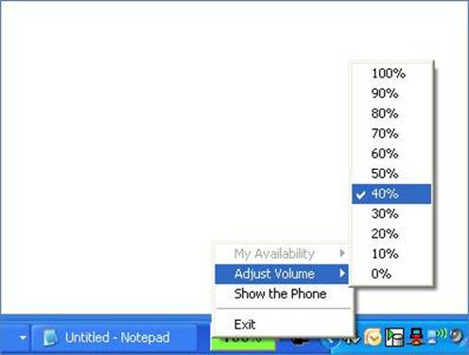
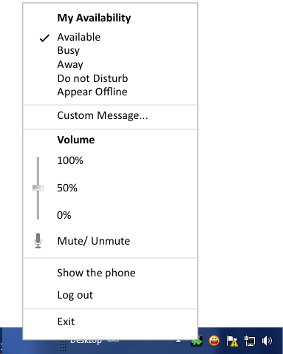
System Tray Mode
Bria can be minimized on startup to be locked into system tray
  Call Center agent right-clicks to access menu, for controlling volume and setting availability status
Current UI implementation
Proposed UI enhancements include:
  Volume slider
  Mute/Unmute
  Remove secondary menu
Proposed UI Enhancements

Slide 15
Bria Call Center Benefits
Exceptional voice quality
  Based on proven Bria technology (deployed to millions of end points), with support for a broad range of HD voice and video codecs
Easy to deploy, with flexible options for remote and local provisioning
Lowest Cost of Ownership when deployed with CounterPath Client Configuration Server (CCS)
  CCS provides centralized provisioning and automatic software updates, as well as Operations tools such as Enhanced Client Debug Logs
3rd party remote call control
  Eliminates need for call center agent to manually answer calls
Fully customizable, with ability to enable or disable specific features
Ability to lock down soft phone client to prevent call center agents from modifying settings
  e.g. Call center agents are not allowed to change status to unavailable
Highly secure, based on SRTP and TLS encryption
Centralized voice quality monitoring (planned for June release)

Slide 16
Core Features
Voice & video calling
Broad range of codecs
  G.711, G.729, AMR, AMR-WB, G.722, H.263, H.263+, H.264
Security / Encryption, including TLS (for SIP signaling) and SRTP (for media)
3rd Party Call Control
  SIP Notify Remote Talk / Hold Event Package
  SIP INVITE with INFO header
Auto-answer (local)
Call recording
Extensive support for USB headsets
  Release-over-release integration with Plantronics and Yealink libraries

Slide 17
Call Center Soft Phone Client
Local & Remote Provisioning
  With local provisioning, Preferences settings can only be changed by the administrator (with special credentials), to prevent Call Center agents from making unauthorized changes
    Well suited to smaller deployments
    Includes Local Login option for shared desktop environments, by prompting Call Center agent to input their SIP user name & password
  With remote provisioning, all provisioning is handled via remote provisioning server
    Recommended for larger deployments
Interoperability Certification
  Pre-integration with leading Call Center solutions from Genesys and Broadsoft
  Planned interoperability with Asterisk and others
  Option to pre-integrate with leading CRM solutions
    Based on updated Bria Application API

Slide 18
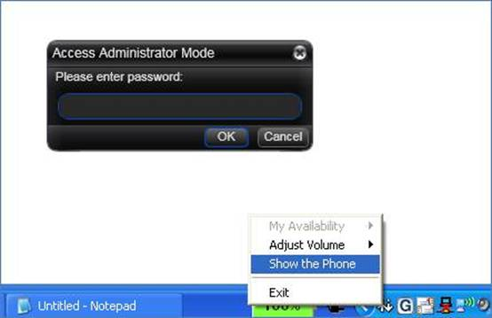
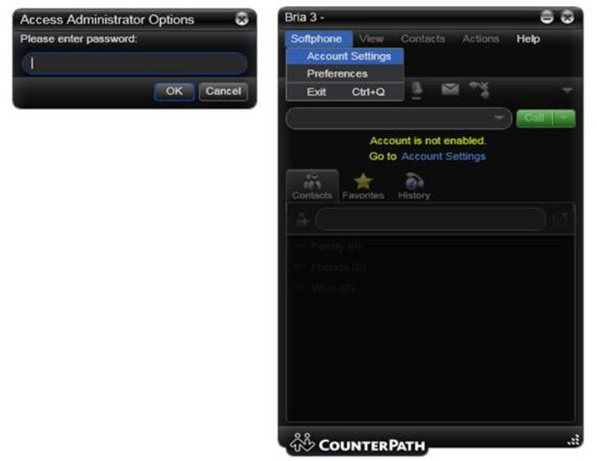
Local Provisioning
Administrator enters credentials to access main Bria GUI and modify Preferences
  Intended for smaller deployments without centralized provisioning server

