Slide 1
Disaster Recovery, Business Continuity, and the Cloud
January 2014
Joel Maloff
Vice President – Channel Development
jmaloff@phone.com

Slide 2
Overview
Disaster Recovery and Business Continuity – What’s the Difference?
Key Questions for DR/BC Planning
How does cloud communications help?

Slide 3
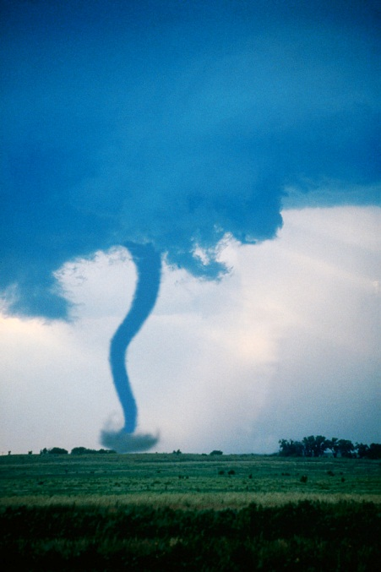
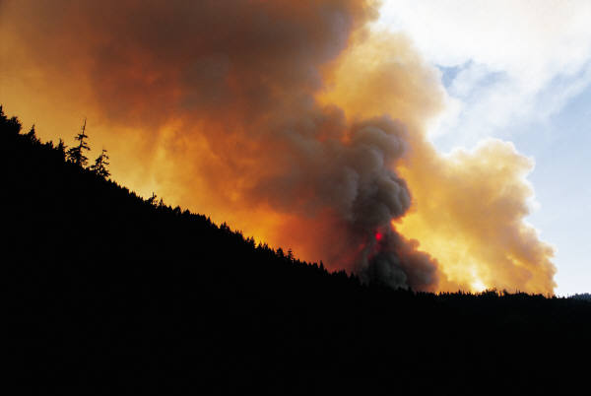

Disasters

Slide 4
Disasters
What other events can compromise a business?
  Sabotage
  Industrial Espionage
  Theft
  Unintentional Incompetence
  Intellectual Property contamination
  Communications disruption

Slide 5
Key Questions for DR Planning
What is the nature or mission of the business that we are seeking to protect?
  Military
  Electronic Commerce
  Healthcare
  Manufacturing
  Communications Carrier
  Legal
  Transportation
  Nonprofit organizations
  Other
Requirements for each vertical industry can differ dramatically, including industry and government regulations.

Slide 6
Key Questions for DR Planning
What are the critical systems and resources that are required to continue operating our business?
  Software
  Hardware
  Data networks
  Written documentation
  Media storage
  People
  Communications
  Physical facilities
  Raw materials

Slide 7
Key Questions for DR Planning
How could each of these critical systems and resources possibly be disrupted?
  Computer viruses, worms, Trojan Horses
  Intentional sabotage
  Unintentional interruption
  Fire, flood, earthquake, tornado, blizzard
  Theft
  Physical intrusion or attack
  Network assault (DDOS, et al)
  Supply chain disruption

Slide 8
Key Questions for DR Planning
Who is responsible for ensuring the integrity and continuity of these business systems and resources?
  Top executives
    Commanders
    CEO
    COO
    CFO
    CIO
  Line executives
    Human resources and personnel
    Sales and Marketing
    Operations
    Manufacturing
    Engineering
    Information Systems
  Managers
  Employees

Slide 9
Key Questions for DR Planning
Disaster Recovery Planning Team
Emergency Response Team

Slide 10
How does Cloud Communications Help?
The premises-based PBX is a single point of failure.
  Cloud-based communications delivers inherent redundancy.
Traditional communications systems are geographically rooted.
  Multi-location organizations may have separate communications systems.
  The cloud provides “virtual identity” and easy failover

Slide 11
How does Cloud Communications Help?
What is DRaas?
  Not all DRaaS providers include voice and/or video communication
What are our legal and regulatory obligations in the case of an “event?”

Slide 12
Conclusions
Disaster Recovery and Business Continuity planning is only effective BEFORE an event.
The cloud offers a variety of tools to help maintain continuity of business regardless of the event.

Slide 13
Joel Maloff jmaloff@phone.com www.phone.com

