Slide 1
SIP Trunk-UC Workshop
IT Expo 2011

Slide 2
Common SIP Applications
SIP Trunking
Remote Desktop
Unified Communications

Slide 3
SIP Trunk-UC Workshop Common SIP Applications
SIP Trunking
A SIP Trunk is a concurrent call that is routed over the IP backbone of a carrier (ITSP) using VoIP technology.
SIP Trunks are used in conjunction with an IP-PBX and are thought of as replacements for traditional PRI or analog circuits.
The popularity of SIP Trunks is due primarily to the cost savings; due to a true convergence of voice and data infrastructure, Increased ROI, the maximizing of bandwidth utilization, open source protocol standards, and more.

Slide 4
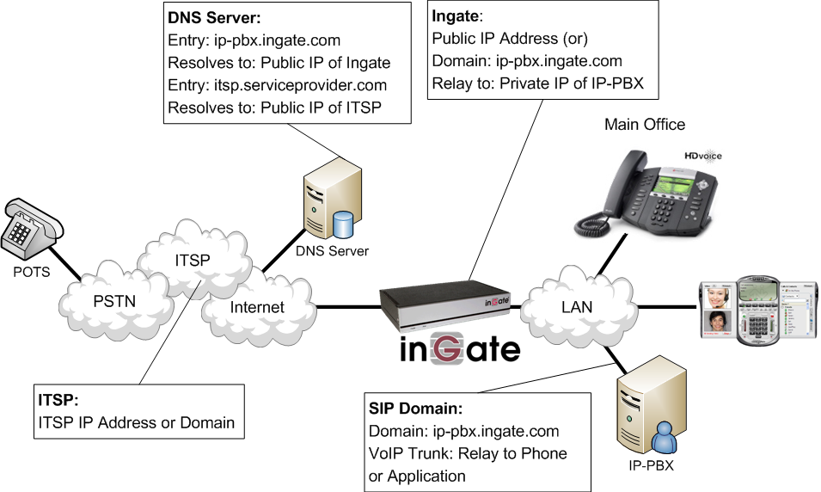
SIP Trunk-UC Workshop Common SIP Applications

Slide 5
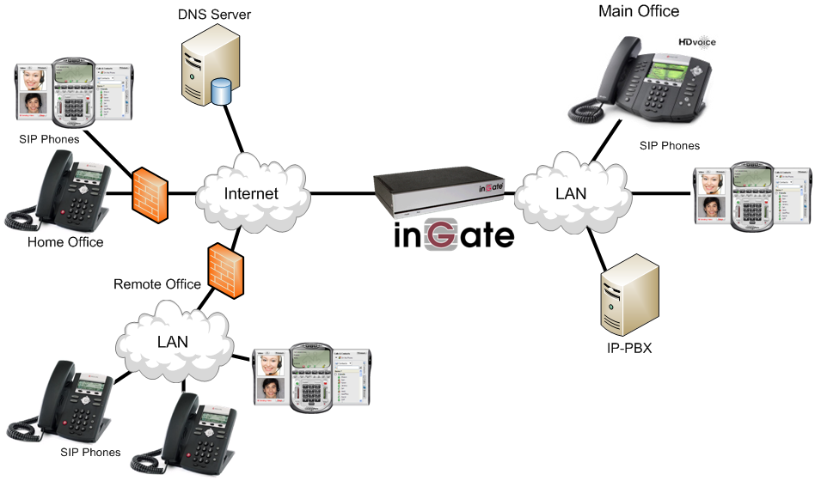
SIP Trunk-UC Workshop Common SIP Applications
Remote Desktop
Extending SIP communications to Remote & Home Offices.
Extension of IP-PBX services using Open Source standardized Protocol
Use of off-the-self SIP Phones and Soft SIP Clients.

Slide 6
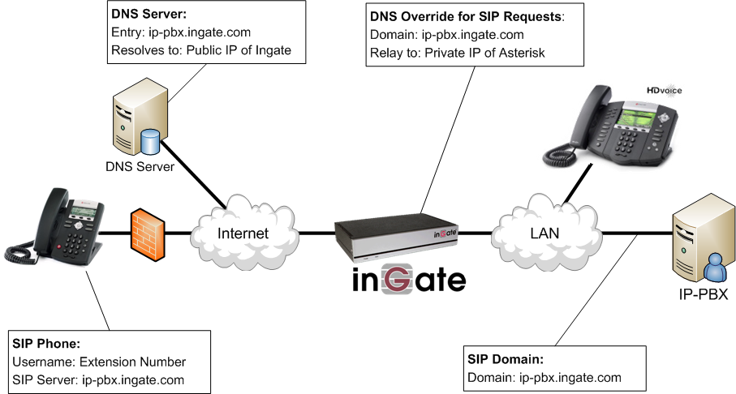
SIP Trunk-UC Workshop Common SIP Applications

Slide 7
SIP Trunk-UC Workshop Common SIP Applications
Unified Communications
Extending SIP communications to a range of different platforms and technologies.
The integration of many different UC Applications such as, Unified Messaging, Presence, Conference Servers, Social Media, Channel Marketing, Smart Phones, Mobile Applications, and Communication Platforms

Slide 8
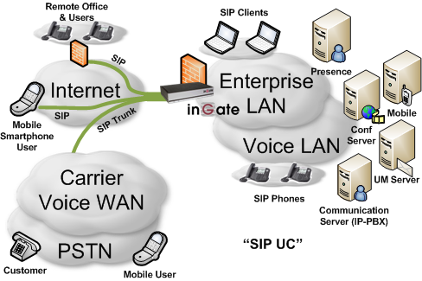
SIP Trunk-UC Workshop Common SIP Applications

Slide 9
Typical Network Deployments
Internet
Managed Service Provider
Hosted or Cloud Services

Slide 10
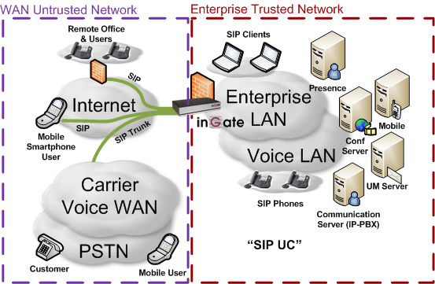
SIP Trunk-UC Workshop Secured Unified Communications over the Internet

Slide 11
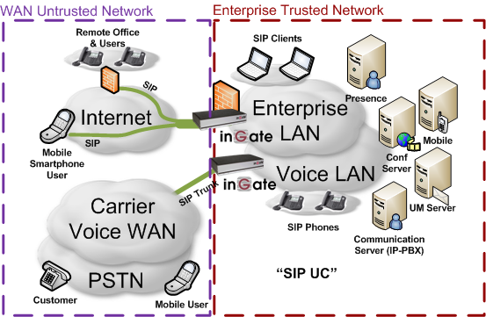
SIP Trunk-UC Workshop Secured Unified Communications over a Managed Service Provider

Slide 12
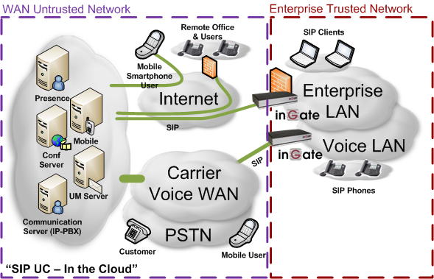
SIP Trunk-UC Workshop Secured Unified Communications over a Hosted Service Provider

Slide 13
The Role of an E-SBC
NAT Traversal
SIP Protocol Interoperability
Call Routing Policies
Security
Quality of Service
Demarcation Point

Slide 14
SIP Trunk-UC Workshop The Role of an E-SBC - NAT Traversal
NAT Traversal
“NAT Breaks SIP”
SIP is an Application Layer Protocol
Network Address Translation (NAT) is an Transport Layer Protocol.
You need both a NAT and SIP Proxy
Topology Hiding
No Advertised Private (Trusted) LAN IP Addresses
Dynamic Port Allocation
Opening and closing ports based on call setup
Firewall behavior and security centered around VoIP

Slide 15
SIP Trunk-UC Workshop The Role of an E-SBC - SIP Interop
SIP Protocol Interoperability
Not all SIP is the same
One vendors implementation may not be the same as another
There are many SIP components and extensions that may be supported on one vendors equipment and not on another
SIP Protocol is an open standard and can be left to interpretation by each vendor
Constant changes and new RFCs

Slide 16
SIP Trunk-UC Workshop The Role of an E-SBC - SIP Interop
SIP Protocol Interoperability
Common Examples
REFER Method is not typically supported by ITSP
INVITE with Replaces Header is not typically supported by ITSP
Various TO and FROM Header URI conformances
Alternate SIP Domain routing requirements
“Native SIP” Implementation vs SIP Trunking
Trunk Group Parameters (RFC 4904)
Diversion Header when Call Forwarding
P-Asserted Identity Header for CDR and Call Trace

Slide 17
Confirmed Interoperability
IP-PBXs
3Com
Aastra
Digium / Asterisk
Avaya
Cisco Call Manager
Fonality
Innovaphone
Interactive Intelligence
Iwatsu
Microsoft
Mitel
NEC
NEC / Sphere
Nortel
Objectworld
SER
Shoretel
Siemens
SIP-Gear
Swyx
Tadiran
More in pipeline...
Service providers
Ingate SIParator®
-or-
Ingate Firewall
360 Networks
Airespring
AT&T
BandTel
Bandwidth.com
Broadvox
Cbeyond
Cellip
Cordia Corporation
Excel Switching
Gamma
Global Crossing
IP-Only
Nectar
Level 3
Netlogic
Net Solutions
Nexvortex
Nuvox
O1
One Communications
Paetec
Primus
RNK Telecom
TDC
Tele2
Toplink
VoEX
VoIP Unlimited
Voxbone
More in pipeline.....
SIP Trunk
Compliant with
Carrier Equipment
Acme Packet
Broadsoft
NexPoint
Sonus
Sylantro
See: www.siptrunk.org

Slide 18
SIP Trunk-UC Workshop The Role of an E-SBC - SIP Interop
SIP Protocol Interoperability
Microsoft Example

Slide 19
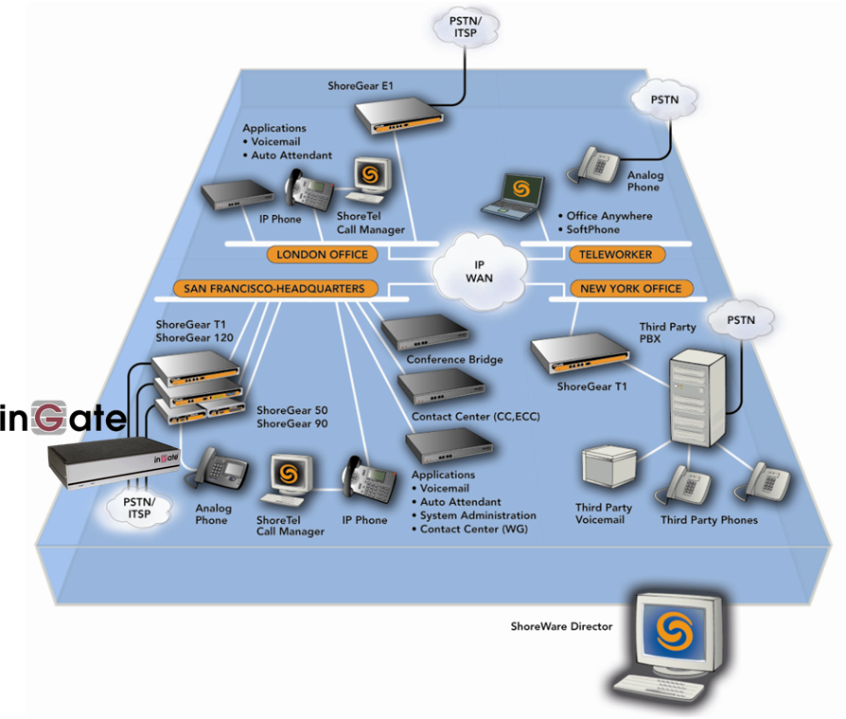
SIP Trunk-UC Workshop The Role of an E-SBC - SIP Interop
SIP Protocol Interoperability
ShoreTel Example

Slide 20
SIP Trunk-UC Workshop The Role of an E-SBC - Call Routing
Call Routing
Access Control Lists
What IP Addresses, devices and other criteria are allowed to traverse the SBC
URI Matching
Matching and Rewriting of URIs
Redirecting to appropriate services
N+1 Sources to N+1 Destinations
Creating Traffic Flow Policies
Defining Call Flow Policies that match the Enterprise Security Policies

Slide 21
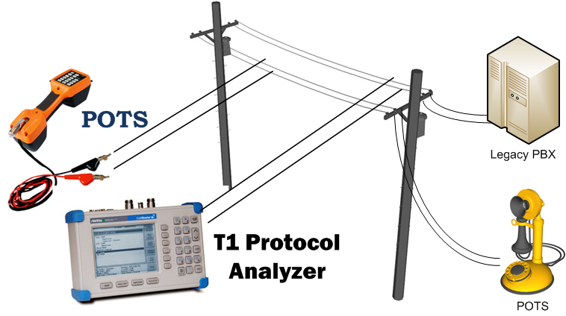
SIP Trunk-UC Workshop The Role of an E-SBC - Security
Privacy
SIP Trunking and SIP UC can be more private than traditional PSTN solutions (POTS and PRI)
Compromising Privacy of POTS and PRI requires physical presence, and is these are never encrypted

Slide 22
SIP Trunk-UC Workshop The Role of an E-SBC - Security
Why is Security Important?
End of Geography
IP Protocol is an OPEN network system, no longer need to be physically present
Any IP Address can connect with any other IP Address, WAN to WAN, WAN to LAN, LAN to WAN, and LAN to LAN.
Prevent Fraudulent Activities
Identify Theft, Toll Fraud, Spoofing, Misuse, SPAM, SPIT, Vishing, Eavesdropping, Data Mining, Reconnaissance
Prevent Disruption of Service
Denial of Service, Fuzzing

Slide 23
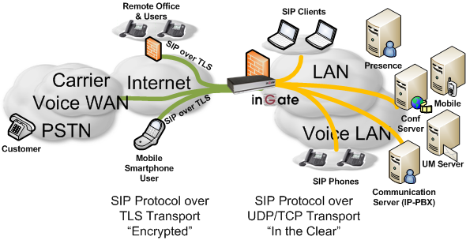
SIP Trunk-UC Workshop The Role of an E-SBC - Security
Why is SIP Security Better than PSTN?
Encryption
Transport Layer Security (TLS) – Encryption of SIP Signaling

Slide 24
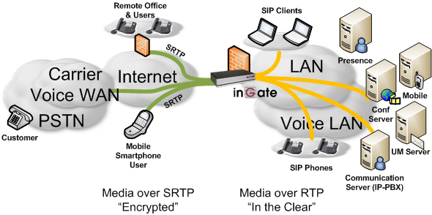
SIP Trunk-UC Workshop The Role of an E-SBC - Security
Why is SIP Security Better than PSTN?
Encryption
Secure RTP (SRTP) – Encryption of Media

Slide 25
SIP Trunk-UC Workshop The Role of an E-SBC - Security
Why is SIP Security Better than PSTN?
Prevent Fraudulent Activities
Access Control
Topology Hiding
Prevent Disruption of Service
Intrusion Detection Service / Intrusion Prevention Service
Blacklisting
More about these later

Slide 26
SIP Trunk-UC Workshop The Role of an E-SBC - Security
Common SIP Attacks
Intrusion of Services (or Stealth of Service)
Devices attempting Register with a IP-PBX in an attempt to look like an IP-PBX extension and gain IP-PBX services
SPIT (SPAM over Internet Telephony)
Toll Fraud
A form of an Intrusion of Service, where malicious attempts to send INVITEs to an IP-PBX to gain access to PSTN Gateways and SIP Trunking to call the PSTN
Denial of Service
INVITE (or any SIP Request) Flood in an attempt to slow services or disrupt services
Or any UDP or TCP traffic directed at a SIP Service on SIP Ports
Indirect Security Breaches

Slide 27
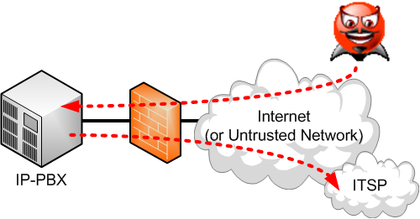
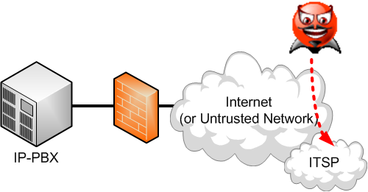
SIP Trunk-UC Workshop Security - Toll Fraud Prevention
What is Intrusion of Service?
A Third Party attempting to defraud either the Enterprise or the Carrier
Devices attempting “Spoof” a Client device in an attempt to look like an extension (or enterprise) and gain services directly

Slide 28
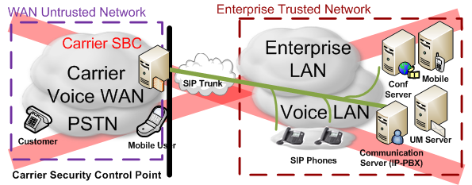
SIP Trunk-UC Workshop Security - Toll Fraud Prevention
General Prevention to Intrusion of Service
Layered Security
Adding security control at different protocol layers and at different points along the SIP call flow
For Example: Don’t put your IP-PBX directly on the Internet (or untrusted) network (i.e. Don’t put all your eggs in one basket)

Slide 29
SIP Trunk-UC Workshop Security - Toll Fraud Prevention
General Prevention to Intrusion of Service
Define the Trust Relationships
No Internet (or untrusted network) IP Address is safe
Define a list of trusted Source IP Addresses (i.e. the client)
Apply specific SIP Call Flow Policies and Routing
Must Authenticate All Transactions
Avoid Weak Passwords

Slide 30
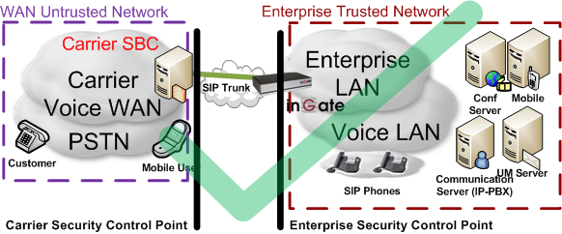
SIP Trunk-UC Workshop Security - Toll Fraud Prevention
General Prevention to Intrusion of Service
Define the Trust Relationships

Slide 31
SIP Trunk-UC Workshop Security - Toll Fraud Prevention
What is Toll Fraud?
A Third Party attempting to defraud either the Enterprise or the Carrier
Penetrate to the PBX and hairpin calls out to the Carrier
Direct defraud to Carrier, mimicking Enterprise credentials

Slide 32
SIP Trunk-UC Workshop Security - Toll Fraud Prevention
General Prevention to Toll Fraud
Layered Security
Adding security control at different protocol layers and at different points along the SIP call flow
For Example: Don’t put your IP-PBX directly on the Internet (or untrusted) network (i.e. Don’t put all your eggs in one basket)
Define the Trust Relationships
No Internet (or untrusted network) IP Address is safe
Define a list of trusted Source IP Addresses (i.e. the carrier)
Apply specific SIP Call Flow Policies and Routing
IP-PBX must not allow Hairpin of calls

Slide 33
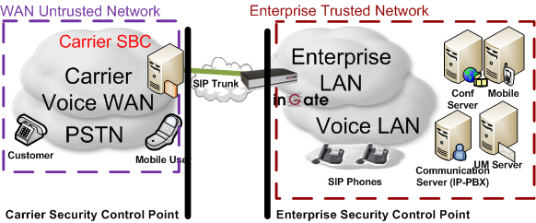
SIP Trunk-UC Workshop Security - Toll Fraud Prevention
General Prevention to Intrusion of Service
Define the Trust Relationships

Slide 34
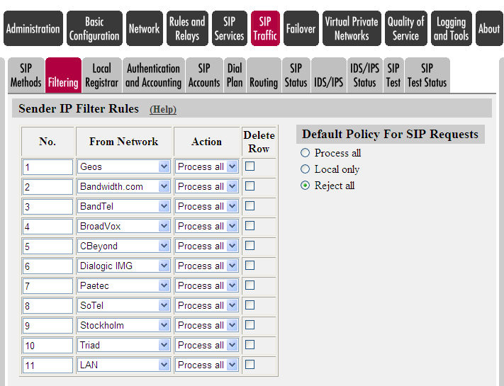
SIP Trunk-UC Workshop Security - Toll Fraud Prevention
Theft of Service & Toll Fraud
How Ingate prevents Stealth of Service and Toll Fraud?
IP Filter Rules
Define only the Trusted Source IP Address(es)
i.e. - the SIP Trunking Service Provider
This provides TCP/IP Layer Control

Slide 35
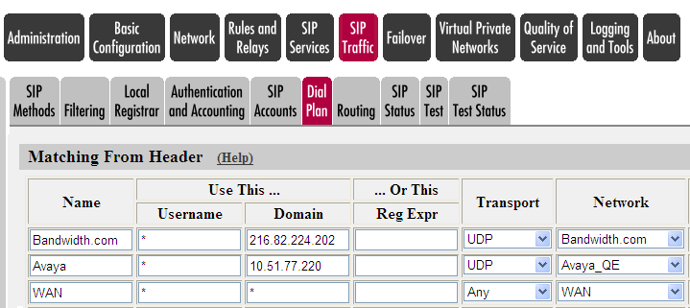
SIP Trunk-UC Workshop Security - Toll Fraud Prevention
Theft of Service & Toll Fraud
How Ingate prevents Stealth of Service and Toll Fraud?
Build a Dial Plan – Call Flow Policies
Source Based SIP Criteria

Slide 36
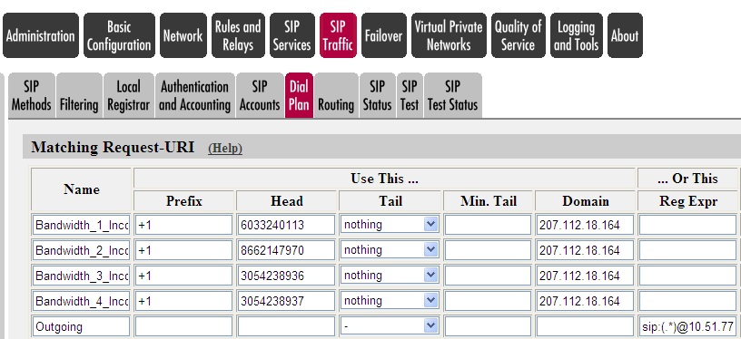
SIP Trunk-UC Workshop Security - Toll Fraud Prevention
Theft of Service & Toll Fraud
How Ingate prevents Stealth of Service and Toll Fraud?
Continue to Build a Dial Plan – Call Flow Policies
Allow only the Known DIDs through

Slide 37
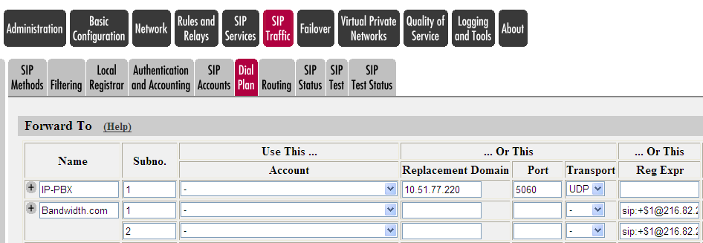
SIP Trunk-UC Workshop Security - Toll Fraud Prevention
Theft of Service & Toll Fraud
How Ingate prevents Stealth of Service and Toll Fraud?
Continue to Build a Dial Plan – Call Flow Policies
Define the Destination

Slide 38
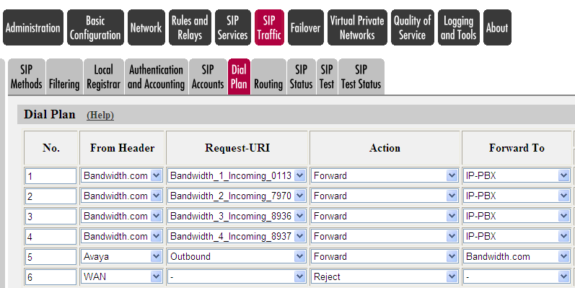
SIP Trunk-UC Workshop Security
Theft of Service & Toll Fraud
How Ingate prevents Stealth of Service and Toll Fraud?
Continue to Build a Dial Plan – Call Flow Policies
Define the Traffic Flow

Slide 39
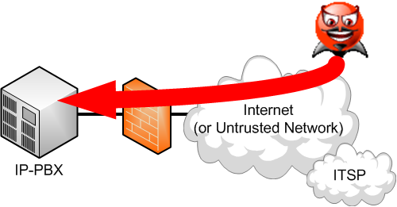
SIP Trunk-UC Workshop Security – Denial of Service Prevention
What is Denial of Service?
A Third Party attack to make a communications resource unavailable to its intended users
Generally consists of the concerted efforts to prevent SIP communications service from functioning efficiently or at all, temporarily or indefinitely
One common method of attack involves saturating the target (victim) IP-PBX with external communications requests, such that it cannot respond to legitimate traffic, or responds so slowly as to be rendered effectively unavailable

Slide 40
SIP Trunk-UC Workshop Security - DoS Prevention
Denial of Service (DoS)
Now A Real Problem in SIP Trunking and UC
DoS occurs mainly over Internet connectivity
Few pure DoS attacks, but scanning for open SIP servers (e.g. SIPvicious.org / friendly scanner) can become a DoS attack.
SMB with single T1 (or multiple) delivery, here the bandwidth can be consumed quickly and easily
Communication Servers have direct relationships with revenue and should be isolated from DoS

Slide 41
SIP Trunk-UC Workshop Security - DoS Prevention
Denial of Service (DoS)
How To Prevent Denial of Service?
Intrusion Detection System (IDS) for SIP Protocol
The Ingate is an independent Network-IDS (NIDS) platform that identifies intrusions by examining network traffic.
Ingate are located at choke points in the network to be monitored, often in the demilitarized zone (DMZ) or at network borders/edges.
The Ingate captures all SIP traffic and analyzes the content of individual packets for malicious traffic.

Slide 42
SIP Trunk-UC Workshop Security - DoS Prevention
Denial of Service (DoS)
How To Prevent Denial of Service?
Intrusion Prevention System (IPS) for SIP Protocol
IPS are considered extensions of IDS
The main differences are:
Placed in-line and are able to actively prevent/block intrusions that are detected.
IPS can take such actions as sending an alarm, dropping the malicious packets, resetting the connection and/or blocking the traffic from the offending IP address

Slide 43
SIP Trunk-UC Workshop Security – Denial of Service Prevention
General Prevention to Denial of Service
Layered Security
Adding security control at different protocol layers and at different points along the SIP call flow
For Example: Don’t put your IP-PBX directly on the Internet (or untrusted network) (i.e. Don’t put all your eggs in one basket)
How to Recognize a DoS Attack
Define the SIP Rate Limits and Blacklisting Policies
No Internet (or untrusted network) IP Address is safe
Define a SIP Method/Request URI/Response Code Pattern
Set a Predetermined Rate Limit and Blacklisting Threshold

Slide 44
SIP Trunk-UC Workshop Security – Denial of Service Prevention
DoS Prevention – IP-PBX or SIP Server
Layered Security
An IP-PBX or SIP Server is a “Mission Critical” application, it has direct ties to corporate revenue.
Recommend not to subject the “Mission Critical” application to DoS handling
Ensure DoS Security is handled separately on a the network edge device, the Ingate SIParator/Firewall.

Slide 45
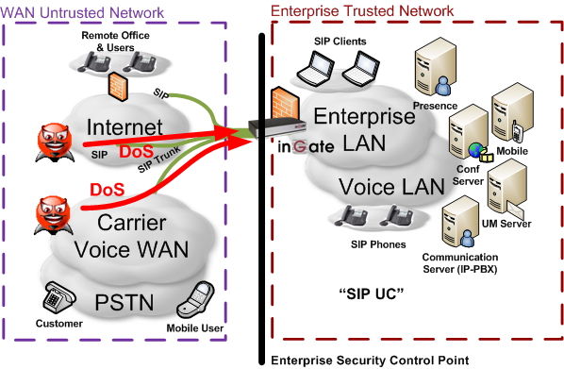
SIP Trunk-UC Workshop Security – Denial of Service Prevention
DoS Prevention – IP-PBX or SIP Server
Layered Security

Slide 46
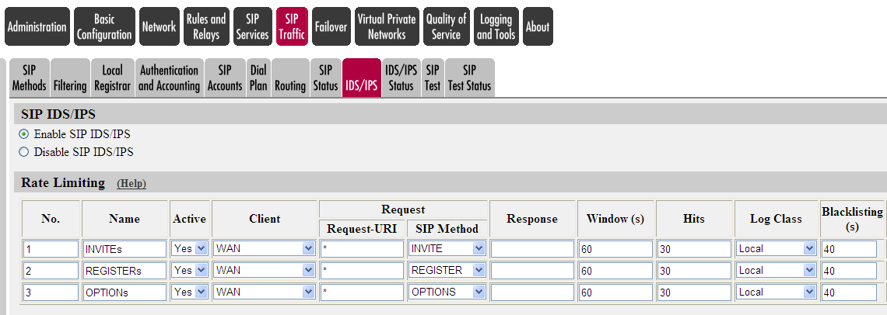
SIP Trunk-UC Workshop Security
Denial of Service (DoS)
How Ingate Prevents Denial of Service
SIP Protocol Method, Response Code Matching/Filtering
Untrusted Network
Blacklist Policy
Traffic Rate

Slide 47
SIP Trunk-UC Workshop Security
Denial of Service (DoS)
How Ingate Prevents Denial of Service
IDS/IPS - Rule Packs
Predefined Rule Packs (signatures) for filtering known industry DoS patterns specific for SIP applications

Slide 48
SIP Trunk-UC Workshop The Role of an E-SBC - QoS
Quality of Service
Traffic Shaping
“Voice First” Prioritization
Call Quality Statistics
MOS Scoring
Packet Loss and Jitter Statistics

Slide 49
SIP Trunk-UC Workshop The Role of an E-SBC - Demarcation Point
Demarcation Point
Security
Protection for Customer and Carrier
Interoperability
Integration with any vendor or service
Call Routing
Call Flow Policies and Access Control
Quality of Service
Voice Quality Stats
NAT Traversal
Topology Hiding

Slide 50
Provisioning
Ingate Startup Tool
Web Admin GUI

Slide 51
SIP Trunk-UC Workshop Provisioning – Startup Tool
Startup Tool
“Out of the Box” setup and commissioning of the Firewall and SIParator products
Update current configuration
Product Registration and unit Upgrades, including Software and Licenses.
Automatic selection of ITSP and IP-PBX
Backup of Startup Tool database
Located at www.ingate.com FREE!

Slide 52
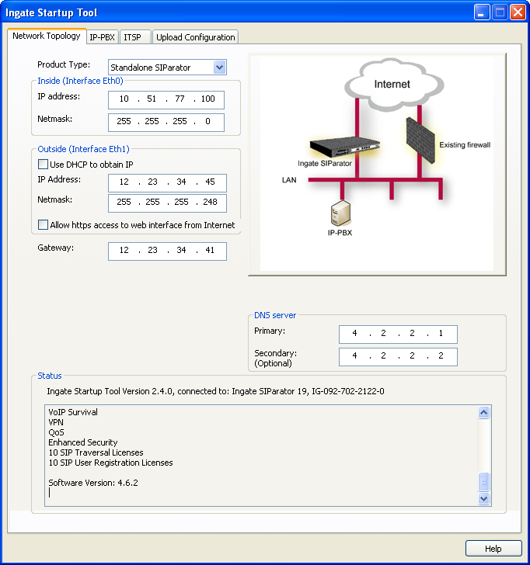
SIP Trunk-UC Workshop Startup Tool – Network Topology
Select the deployment according to the picture
Assign IP Addresses, the tool will config the Ingate.
Status Information, helpful for troubleshooting
Notes:
The following two pages show the configuration of the Ingate while installing a SIP trunk. The Ingate Startup Tool with preconfigurations is being used.

Slide 53
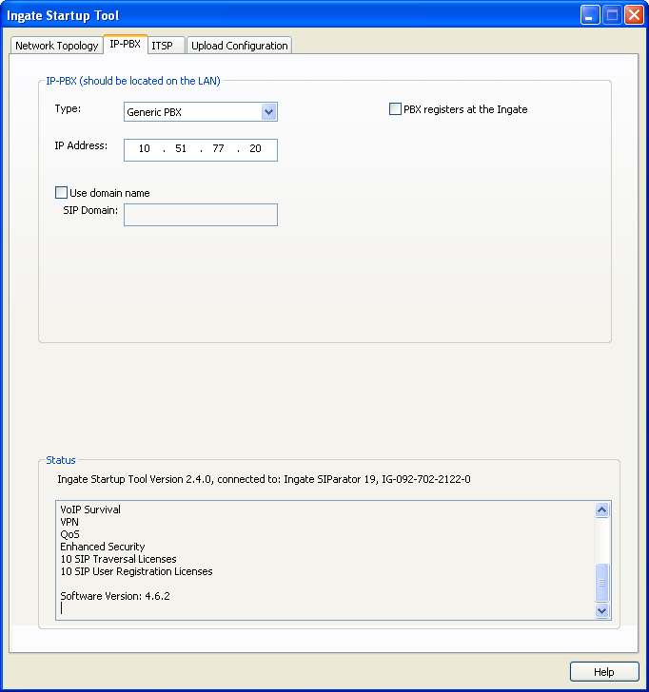
SIP Trunk-UC Workshop Startup Tool – IP-PBX Selection
Select IP-PBX Vendor and Model
Assign the IP-PBX IP Address
For every IP-PBX vendor on the List Ingate has captured the programming requirements to ensure quick and easy config
Assign the IP-PBX Domain (if required)
Status Information, helpful for troubleshooting
Notes:
The following two pages show the configuration of the Ingate while installing a SIP trunk. The Ingate Startup Tool with preconfigurations is being used.

Slide 54
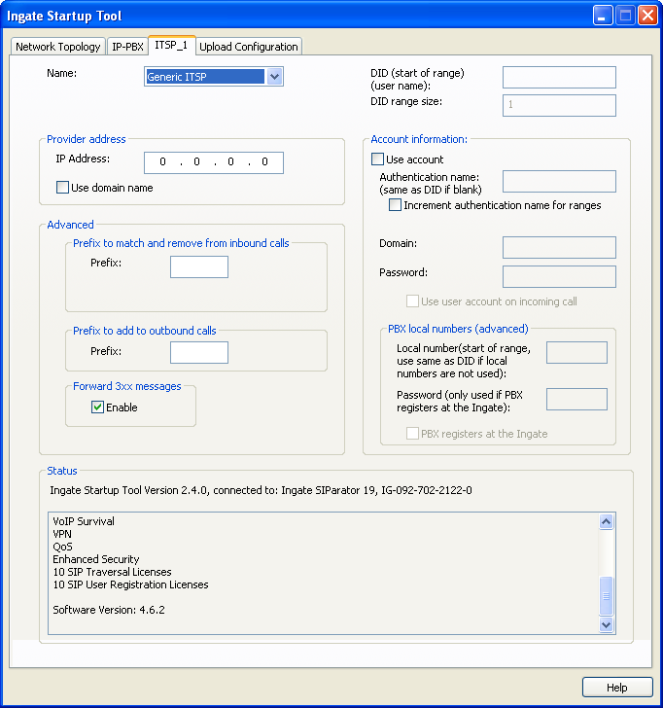
SIP Trunk-UC Workshop Startup Tool – ITSP Selection
Select ITSP Vendor
For every ITSP vendor on the List Ingate has captured the programming requirements to ensure quick and easy config
User Account Information, DID Assignment and Registration Authentication
Assign the ITSP IP Address
Status Information, helpful for troubleshooting
Notes:
The following two pages show the configuration of the Ingate while installing a SIP trunk. The Ingate Startup Tool with preconfigurations is being used.

Slide 55
SIP Trunk-UC Workshop Provisioning – Web Admin GUI
Web Admin GUI
Web Based Graphical interface
Enterprise Focused GUI
Easy to use and navigate through the application of SIP Trunking and Security

Slide 56
SIP Trunk-UC Workshop SIP Interop – SIP Trunk
SIP Trunk Configuration
Single point of SIP Trunk configuration GUI.
Individual SIP Trunk Parameters for Interop Settings and SIP Customization
Can provide a Main Trunk Line OR Can provide individual SIP Trunk support, both for Incoming and Outgoing Traffic.
Can work independently or has legacy support in existing Dial Plan

Slide 57
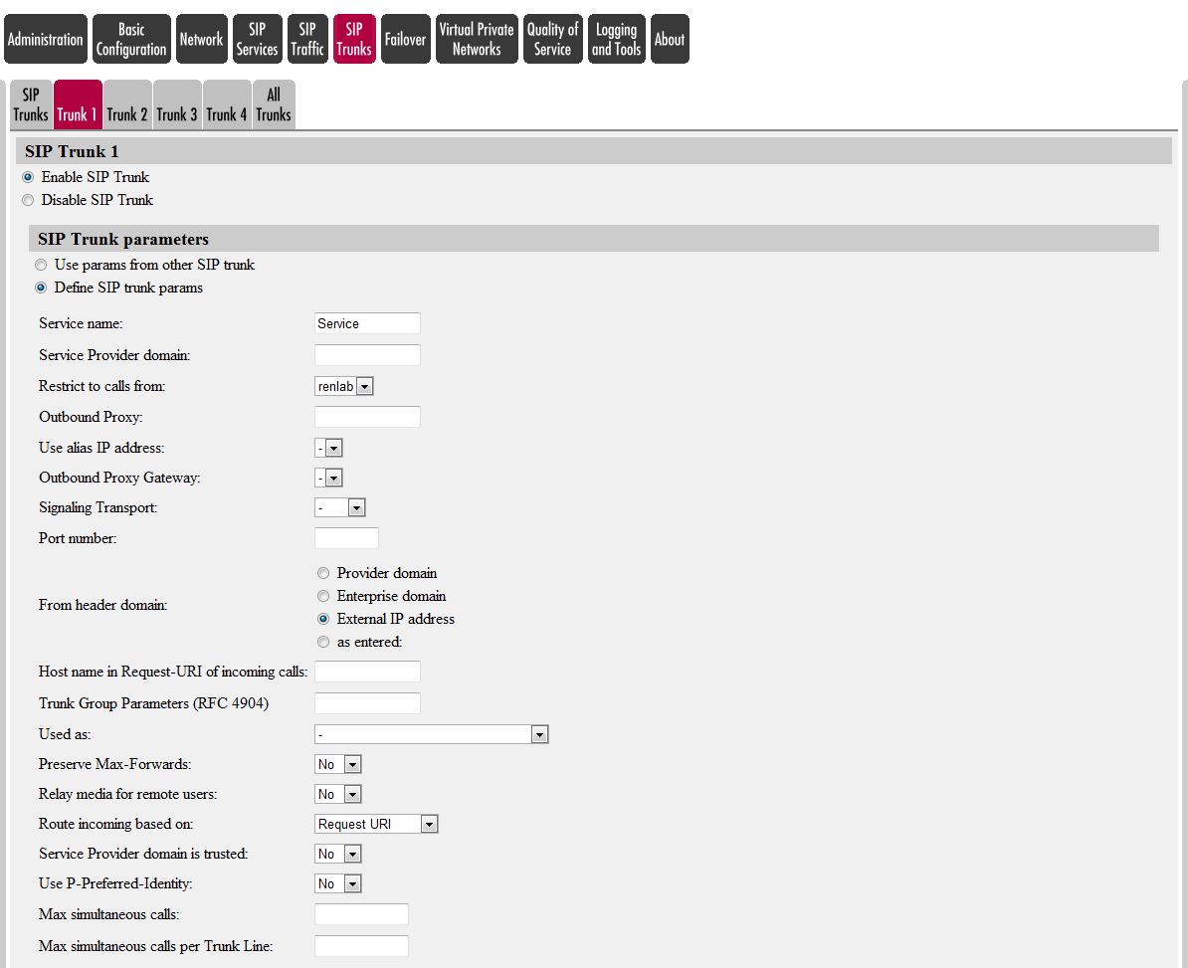
SIP Trunk-UC Workshop SIP Interop – SIP Trunk
SIP Trunk Configuration – SIP Trunk Parameters

Slide 58
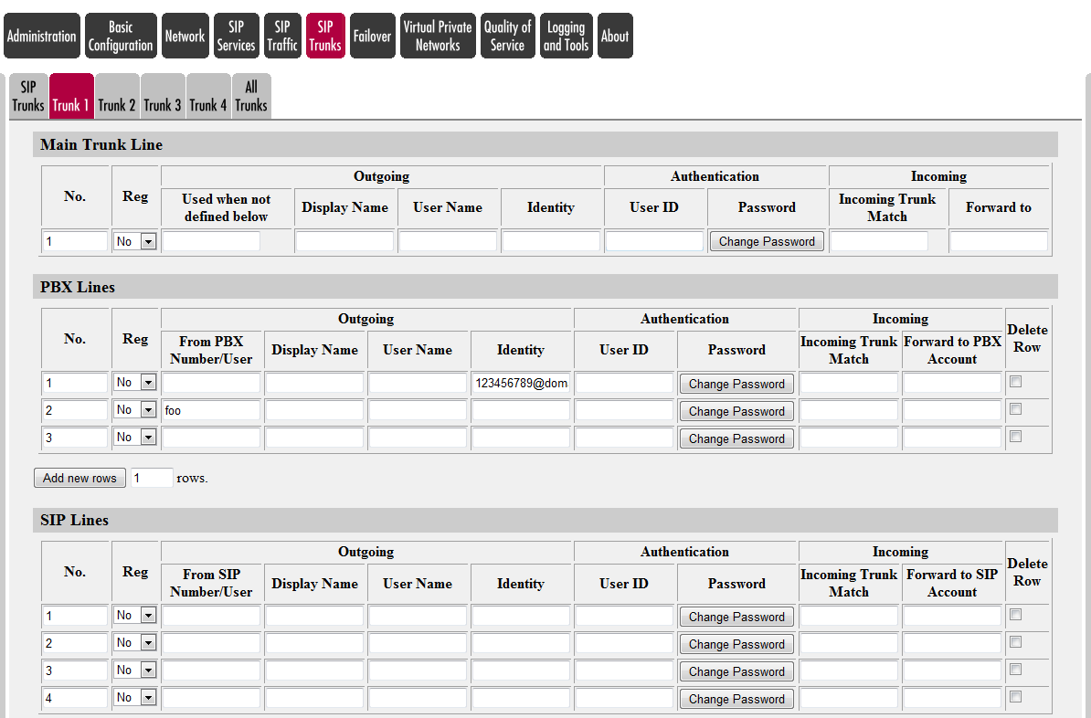
SIP Trunk-UC Workshop SIP Interop – SIP Trunk
SIP Trunk Configuration – Main & PBX & SIP Lines

Slide 59
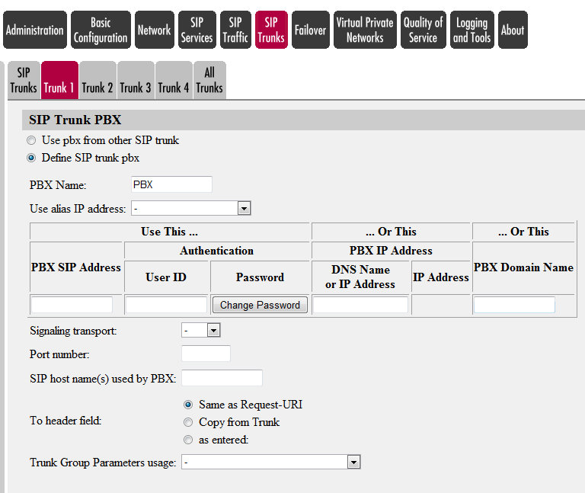
SIP Trunk-UC Workshop SIP Interop – SIP Trunk
SIP Trunk Configuration – PBX Trunk

Slide 60
Monitoring and Support
Call Quality Statistics
Packet Captures
Call Detail Records
Logging

Slide 61
SIP Trunk-UC Workshop Monitoring and Support - Call Quality Statistics
CDR & Call Quality Statistics
RADIUS Integration
Call Detail Recording
Records all Incoming and Outgoing calls
Call Quality Stats appended to CDR Records
MOS Scoring
Mean Opinion Score (MOS). MOS gives a numerical indication of the perceived quality of the media received after being transmitted and eventually compressed using codecs.
Packet Loss and Jitter Statistics
Jitter is the variation in delay, which typically causes Echo
Packet Loss is loss of audio, which causes broken speach

Slide 62
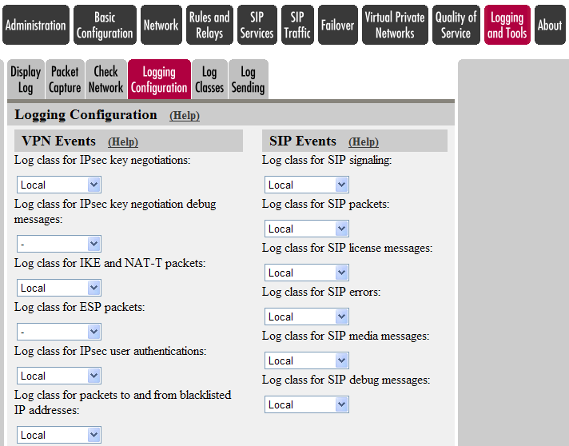
SIP Trunk-UC Workshop Monitoring and Support - Logging
Logging Configuration
SIP Events will ensure SIP calls are logged.

Slide 63
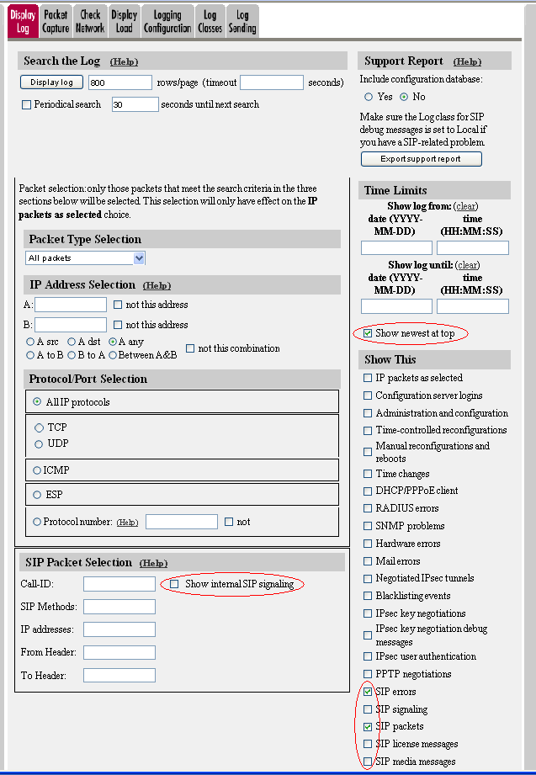
SIP Trunk-UC Workshop Monitoring and Support - Logging
Logging & Tools
Display # Rows/Page
Show Newest on Top
Select SIP Log Attributes
Select “Show internal SIP Signaling”

Slide 64
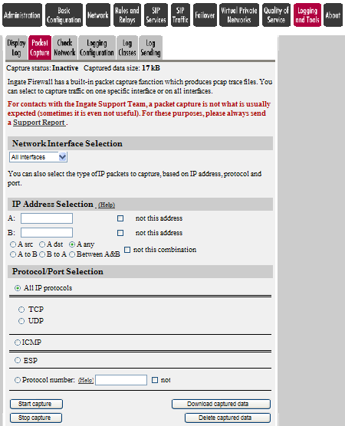
SIP Trunk-UC Workshop Monitoring and Support – Packet Captures
Packet Capture
Creates a Wireshark PCAP network trace.
Network Interface Selection – All Interfaces
Start – Stop - Download

Slide 65
THE END

