Slide 1
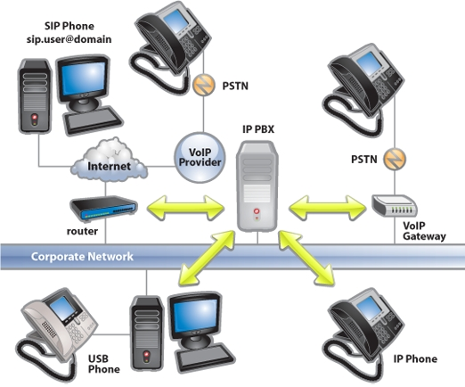
The IP-PBX
Phil Bowers
Global Marketing Communications Manager, Grandstream Networks
pbowers@grandstream.com

Slide 2
20%-25%
…of SMBs in the USA use VoIP in 2013

Slide 3
The Analog/Legacy PBX is dying…
Advantages of IP PBXs...
Single Network
Easy installation an setup
Traditional PBXs require their own network and it is quite expensive/time consuming to build a separate telephone network spanning the entire business location(s). With IP Telephony, the Computer Network can be used to carry voice, video, data, and mobility features
2. Multiple Office Peering
IP PBXs transmit voice calls over the WAN IP Network
3. GIGANTIC Cost Savings
No Long distance with VoIP
Sip Trunking
4. Much easier System Management
Web User Interface
Hosted IP PBX (managed by provider)

Slide 4
The Analog/Legacy PBX is dying…
Advantages of IP PBXs...
5. Softswitches
Some IP PBXs are software that can be run on exisiting computers/servers
Asterisk, Tribox, FreePBX
6. Integration of multiple technologies
Unified Communications (voice, video, data, and mobility
Mobile – softphone use
Fax
CRM software
7. State-of-the-art Security
Encryption (TLS and SRTP)
8. Scalable
Add more users/extensions as you need them
Choose and customize the features you need
9. SIP!!!
Open source technology eliminates vendor lock-in
10. SIP Endpoints rock!
Power of the internet and mobile devices in one

Slide 5
What is an IP-PBX
PBX = Private Branch Exchange
The central switching system for phone calls, video calls, email, fax, instant messaging, conferencing solutions, SMS, and mobile telephony within a business. The PBX handles internal traffic between stations and acts as a gatekeeper to the outside world.
Notes:
Description of what an IP PBX is, what it does, etc.

Slide 6
IP-PBX System
Wireless/Fiber IP Network
IP-PBX (or softswitch/hosted network)
Endpoint (ex: IP Phone)
Notes:
Components needed to set up an IP PBX system

Slide 7
External Calls
Endpoints
IP Phones
Conferencing Solutions
IP Cameras
Fax Machine
Modems
PBX
Telephone Service/
SIP Trunk
Outside World
Internal Calls
PBX
Endpoint being contacted
Endpoints
Notes:
What a PBX does – it routes calls and traffic

Slide 8
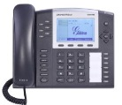
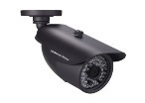
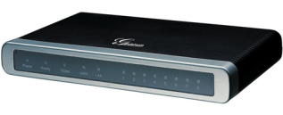
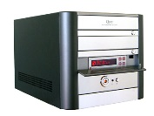
Basic IP-PBX Setup
Fax
IP Phone
IP Video Phone
E1
PSTN
PBX
IP Network
FXO
IP Camera
Local PSTN
VoIP Gateway
Analog Telephone
Analog PBX
Notes:
Describe the basic setup of an IP PBX system, what connections are needed, what other hardware can be used, etc

Slide 9
Shared Access to Limited Resources
Rather than having a separate line for each phone, a PBX allows a business to share a smaller pool of lines across the entire business.
Notes:
Businesses do not need the same amount of lines as employees, or even close to it. IP PBX allows your business to buy limited lines and maximize use of each line without the paying for lines for all employees

Slide 10
The Backbone of Your Business
Call-routing
Call Transfer
Call Block
Voice Messaging
Call Queue
Voice Conferencing
Call Forwarding
Call Retrieval
Music On Hold
Ring Group/Hunt Group
Call Recording
Call Park
Intercom/Paging
Call Hold
Do Not Disturb (DND)
IVR
Auto-Attendant
Click to Dial
Busy Lamp Field (BLF)
Codec support
Fax
Phonebooks
Call Detail Reporting (CDR)
Voicemail/fax forwarding to email
System Backup
Mobility applications
Notes:
Go through important IP PBX features, describe those that need more descriptions

Slide 11
IP-PBX Must Have Features
Voice Messaging (voicemail to email)
Mobility Applications (remote IP extensions, find me/follow me, softphone applications, etc)
Conferencing (voice and video)
Reporting (CDR, Call-Recording)
Notes:
These features are becoming incredibly popular and necessary in todays business world

Slide 12
Basic Advantages of IP-PBX
One-time deployment cost
Enormous savings on Service costs
Built-In Features (IVR, auto-attendant, etc.)
Data capability – CDR, Call Recording, etc.
Multiple-office peering

Slide 13
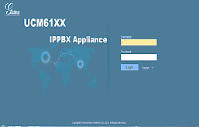
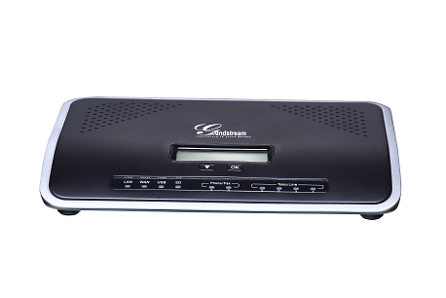
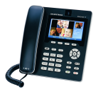
IP-PBX Peering
TLS/SRTP/SIP/RTP
GXP2124v2
DHCP
PSTN
Office 1
Auto - detection and
Provisioning
GUI
Web Admin
HTTP/HTTPS
Up to 16
FXO lines
GXV3175v2
TLS/SRTP/SIP/RTP
FXS 1
PBX
LAN
TCP/RTSP
GXV3672_HD/FHD
FXS 2
…
Office 2
WAN
TLS/SRTP/SIP/RTP
GXV3140v2
GXP2120
Internet
Network
…
SIP Trunk Provider 1
LAN
WAN
DP715/710
PBX
SIP Trunk Provider 2
Notes:
Using diagram, describe how IP PBX allows for peering of multiple office, and what that peering brings to a business.

Slide 14
Unified Communications
= Voice, Video, Data, and Mobility features
Notes:
Overview of unified communications, what features it brings, and how it incorporates into the IP PBX

Slide 15
Unified Communications
Voice
Traditional voices features
Integration of voice features with video, data, and mobility applications
Door Access cameras
Video Surveillance cameras
Softphone applications
UC desktop clients
Notes:
Overview of unified communications, what features it brings, and how it incorporates into the IP PBX

Slide 16
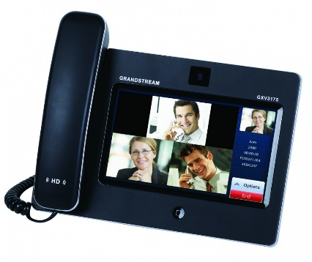
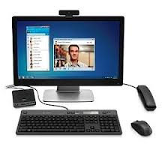
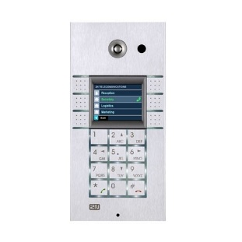
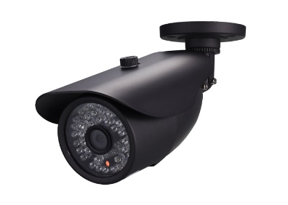
Unified Communications
Video
Video phones
UC Desktop clients
SIP Door Cameras
IP Video Surveillance Cameras
Video conferencing systems
Notes:
Overview of unified communications, what features it brings, and how it incorporates into the IP PBX

Slide 17
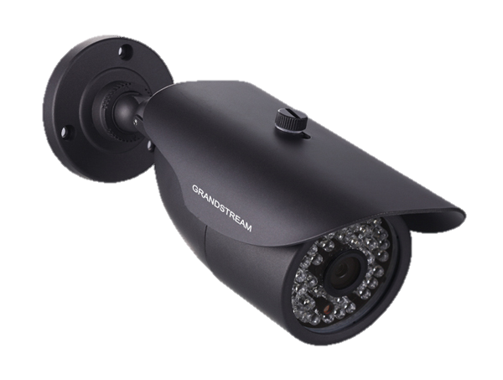
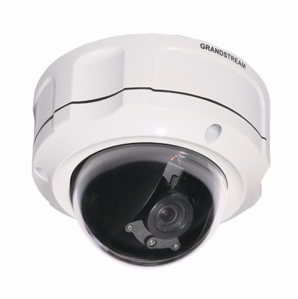
Unified Communications
Video
Video Surveillance Integration
Create a comprehensive solution to view, monitor and receive alerts from IP cameras
Register IP cameras to the PBX
Make video calls to IP cameras to view live feeds
Speak through cameras with 2-way audio & video (door entry)
IP cameras can be set to automatically call video phone when alert is triggered
Receive alerts from anywhere in the world
Notes:
Create a comprehensive video surveillance solution using the UCM6100 series

Slide 18
Unified Communications
Data
Integrated data features
CRM programs
Call Recordings
CDR
Phonebook files (LDAP)
Voicemail/fax forwarding to email
Automatic system backup
BLF
Remote Access BLF
Notes:
Overview of unified communications, what features it brings, and how it incorporates into the IP PBX

Slide 19
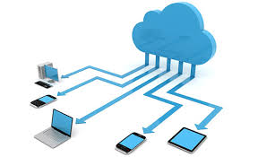
Unified Communications
Mobility
Desktop UC clients
IM, Voice calls, video calls, CRM
Access everything you need from anywhere
Call recordings
CDR
Fax
Voicemail
System settings
System backup
Softphone Applications
Multiple office peering
Notes:
Overview of unified communications, what features it brings, and how it incorporates into the IP PBX

Slide 20
Advantages of IP-PBX for Employees
Mobility – access to extension, voicemail, fax, call-routing, video conferencing, SMS, Presence, etc.
More Communication Options = More Productivity – fax, voice, video conferencing, video surveillance, data, and more
More Voice Options – Built-in call-routing, call transfer/park/queue/hold, Ring/Hunt Group, IVR, auto-attendance, etc.
Interconnected Business – one platform for all communications, making it easier then ever to access any phonebook, call, fax, and keep in touch with fellow employees
Keep Closer contact with Clients – video calls, video conferencing, voice conferencing, etc.
Notes:
The advantages an IP PBX brings to the lives of employees

Slide 21
Advantages of IP-PBX for Businesses
Enormous Cost Savings
More Communication Options = More Productivity
Future proof – easily add users/features
Connect Multiple Offices/Locations
Unified Communications functionality
Web User Interface Management
Features built-in
Notes:
Why should a business use an IP PBX

Slide 22
Hosted IP-PBX vs. On-Premise IP-PBX
Hosted IP PBX
PBX hardware is Off-site
Support/Maintenance controlled by Service Provider
Add new users online
Package deals
On-Premise IP PBX
PBX hardware is on-site
Support controlled on-site
Full on-site control of setup, management, additions, etc
Web User Interface
Notes:
Hosted vs on-premise introduction. Simply overview both, do no recommend either

Slide 23
Hosted IP-PBX vs. On-Premise IP-PBX
Considerations
Total Cost of Ownership
Bundled Features
Ease of Customization
User Experience
Cost and Ease of Tech Support
Notes:
What to consider in making a hosted vs. on-prem choice

Slide 24
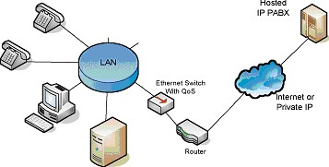
Hosted IP-PBX
Also known as “Cloud PBX”
Outsources PBX hardware and control
Often bundles various services
Often requires service contracts/annual contracts
Hosted provider controls maintenance, updates, etc.
On-premise endpoints connected to Hosted PBX through the internet
Notes:
Hosted vs on-premise introduction. Simply overview both, do no recommend either

Slide 25
On-Premise IP-PBX
PBX is at your business location
You choose service provider
Maintinence and additions are done by business (IT Manager, Installer, Reseller, etc.
Ability to pick all features freely
Business has full control of PBX
Notes:
Hosted vs on-premise introduction. Simply overview both, do no recommend either

Slide 26
Cost Considerations
Hosted IP-PBX vs. On-Premise IP-PBX
Setup costs
Maintenance Costs
Ongoing Costs
Service Provider Costs
Fees
Contracts/Leases
Notes:
What to consider in making a hosted vs. on-prem choice

Slide 27
Future Expansion
Hosted IP-PBX vs. On-Premise IP-PBX
Control of Expansion?
Risk
Flexibility of Expansion?
Notes:
What to consider in making a hosted vs. on-prem choice

Slide 28
Control Considerations
Hosted IP-PBX vs. On-Premise IP-PBX
Internal control or out-sourced control
Cost of internal control vs. out-sourced control
Notes:
What to consider in making a hosted vs. on-prem choice

Slide 29
Flexibility
Hosted IP-PBX vs. On-Premise IP-PBX
Pre-set list of features vs. Customizable features
2. Do you have the technical resources?
Notes:
What to consider in making a hosted vs. on-prem choice

Slide 30
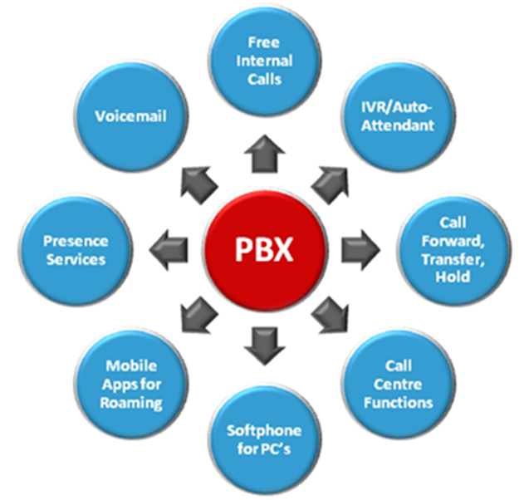
Range of Features/Options
Hosted IP-PBX vs. On-Premise IP-PBX
Does it have the feature set you want?
2. How easy is it to add features?
Notes:
What to consider in making a hosted vs. on-prem choice

Slide 31
Implementation
Hosted IP-PBX vs. On-Premise IP-PBX
Initial Setup time and cost of setup
2. Support/control off-site vs. on-site
Notes:
What to consider in making a hosted vs. on-prem choice

Slide 32
Phil Bowers
Global Marketing Communications Manager, Grandstream Networks
pbowers@grandstream.com

