Slide 1
Presents Extending unified communications
By: Louis Huynh
Grandstream Technical Support Manager
Notes:
I’d like to thank you all for showing up today.
I hope everyone isn’t too hungry cause I have a whole entire hour to talk about SIP compliance a ton of RFC references. Hahaha
I’m just kidding with you. Today I’d like to discuss how businesses now are changing from traditional communication to a unified communication. But before we begin, I’m going to share some figures with you.

Slide 2
2013 VoIP Market
$70.9
70.9
Billion
Notes:
Can anyone take a guess as to what this figure represents?

Slide 3
2020 Projection
$136.76
2020 Projection
Billion
Notes:
and is projected to be worth US$136.76 billion by 2020
The subscriber base of the global VoIP market is expected to reach 348.5 million by 2020.
Now let’s narrow the region down to just the United States.

Slide 4
United States
32,000,000
VoIP Subscribers
Notes:
In 2013 United States was reported having the most VoIP subscribers at a little over 32 million.
However…

Slide 5
United States
30%
VoIP Proliferation
Notes:
The US also had one of the worst percentages of VoIP proliferation: 30% of broadband subscribers.
Advisory Reports and surveys indicate that 2/3 of SMBs in the US are without a Unified Communication strategy. That’s telling me one thing. That there are plenty of businesses out there that can benefit from a UC solution.

Slide 6
UC
and
PRODUCTIVE
Growth
Efficiency
So Simple
Notes:
Unified Communication or UC has been getting very popular in the IT circles lately, and I could see why with promises of growth and efficiency.
UC ties together the way we communicate. Combining desktop software, video conferencing and SIP trunking technology. Which makes our work SIMPLER and MORE PRODUCTIVE.
However, UC presents a unique challenge because even though we know UC improves collaboration, customer service, employee efficiency and even moral, how do you assign a hard dollar figure to those benefits. Better yet, how do you convince your CFO on return of investment?

Slide 7
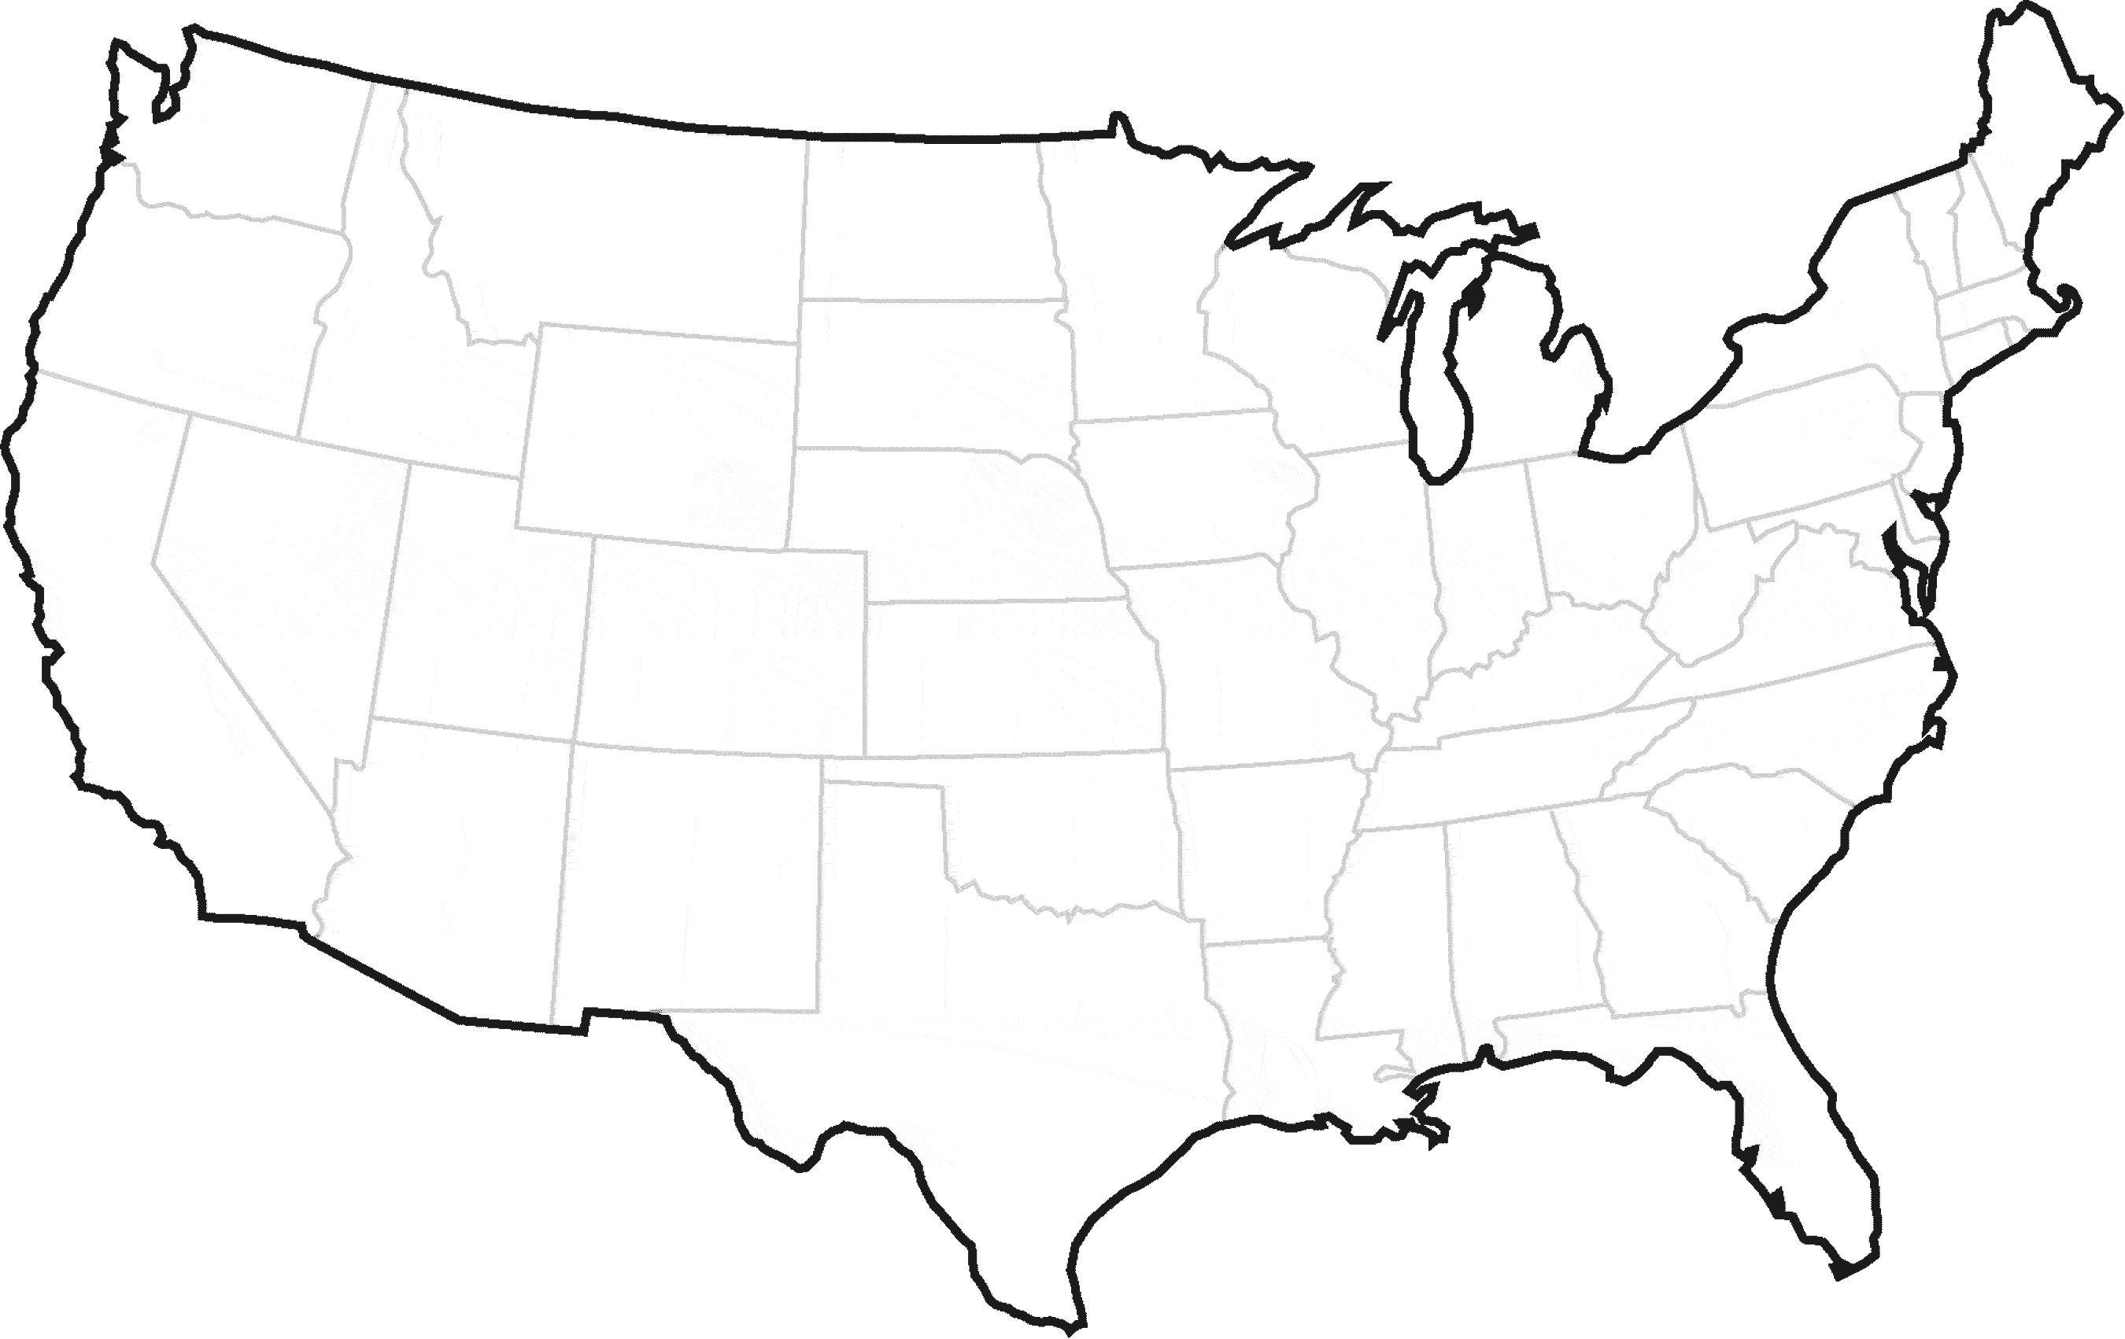
ND
$
LEC
$
$
WV
CA
LEC
LEC
$
$
$
$
WAN
$
$
30-50%
Notes:
-How do you build a solid case for UC? SIP Trunking!
-So where does the SIP trunking cost savings come from?
-Let’s first take a look at how traditional phone services work.
Each of your location requires a connection to the local phone company.
You probably have a telephone line or PRI trunk
and maybe even a dedicated PBX
You pay for the connection
You pay for the dedicated PBX
And the maintenance of the phone systems
You’re also paying for local access fees and long distance fees
All of these costs can really add up
Especially when you consider managing different bills with different vendors.
With sip trunking you can eliminate many of these costs because voice becomes another application on your data network.
Now you start getting rid of all these connections to the local phone company
The dedicate PBX from each location
And instead use an IPPBX and share it’s capabilities with your offices over your own data network.
Since you’re passing your voice traffic over your own network, when calls are placed between any of your offices, you no longer incur any additional charges.
These costs alone can be substantial savings. Anywhere between 30-50%.
This will allow your offices to become scalable and allow for a UC solution to put in place.
The idea of unified communications (UC) is simplification and real-time access to people, applications, data and collaborative support.
In an "always-on" world where businesses are demanding more of employees, UC delivers value by reducing costs and simplifying operations while giving employees the flexibility to stay connected and work from anywhere as though they were in the office. With businesses becoming more competitive, it seems that every customer contact, every internal collaborative session, every opportunity should not be missed.

Slide 8
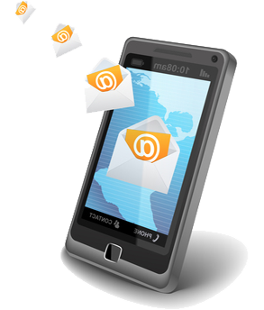
Does your product truly deliver the greatest results?! Call me back!
So..does your product truly have the greatest results?
Hi Jane! But of course! My flux capacitors have more than 1.21 Gigawatts!
Notes:
Scenario #1 (staying connected)
Here’s a scenario that shows the simplest form of Unified communications.
A customer calls to ask a question about one of your products.
They unfortunately call after business hours and decide to leave a voicemail message. After they hang up, UC translates the message into digital form and emails it to your sales team. Your sales manager receives the message, in email form, on their mobile device and is then able to call the client back.
Another way that this could have been handled is to perform a forwarding or even a following function. Giving the sales manager the ability to receive calls even when away from the office. This introduces a single number reachability as well.
So, you’re not tied at the desk at the office. It Allows for remote call handling. It will reduce the number of missed calls, voicemails and emails.
Ok, with that implemented, you’re not likely to miss another opportunity. Now I have to ask, how’s your customer service?

Slide 9
TRANSFER GAME!!!
Notes:
Scenario #2 (presence & customer service)
Improving customer service is not just about being available to take the call, but it is also knowing that the customer is being handled properly. I’m not sure if everyone here has experienced this before, but I’ve been put through what some would call the “transfer game”.
So I call into Company X’s customer service center requesting for help, with my virtue of patience I waited for 10 minutes for someone to answer the call, only to find that it’s not the right department. So they decide to transfer me to another department. Testing my patience, I waited for another 10 mins. Someone answers the call, I go through the process of explaining my whole entire issue again. The agent on the line says they need to get me in contact with the appropriate personnel. Great! So I get transferred. The phone rang at least 30 times and finally someone answered. But it wasn’t a HUMAN! It was an automated prompt telling me that the agent is not available and that I will be placed back to the previous queue.
Out of sheer determination and will power, I repeated this process at least 4 times, and each time, I was transferred to an unavailable agent. I’d have to say, I’m impressed that the call was never abandoned during this time. I did finally reach the proper personnel and my issue was ultimately resolved in the end. But my experience could have been a heck of a lot smoother. A lot less time consuming. So I wondered, why have your customers go through this?
With a UC solution it could have been avoided by a simple glance for presence which would have made this process easier and less frustrating. Presence isn’t something that’s obtrusive or in your face. Presence represents the availability and willingness of a person to communicate. With presence the Agent could have seen who is away and who is available to take a call. Making the right choice the first time around. Which makes the customer’s experience more enjoyable, if not, less painful.
Contact Service agents can find subject matter experts using IM and presence technology to quickly solve customer problems.
Besides from the simple presence info, IM(instant messaging) has become one of the single most important tools that enables communication and most importantly collaboration.

Slide 10
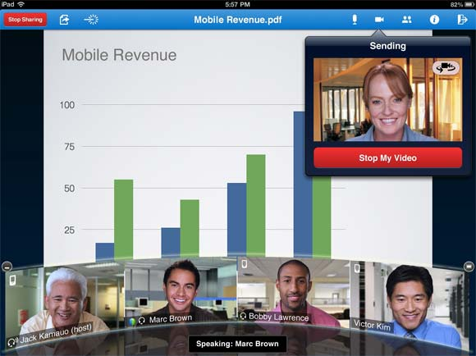
Collaboration
Notes:
Scenario #3 (Video Conferencing & Collaboration)
The term “collaboration” has become very popular amongst UC vendors. IM/Presence, email, voice are the many choices you have for collaboration. One method to emphasize on is video conferencing.
Getting everyone together for a video conference use to be a job on it’s own, but is now as easy as clicking on a link. Members are able to join from all different communication platforms, whether it be from a laptop and even a smartphone.
In this scenario we have Bob from the Boston office. Bob is a sales manager with a tight deadline to deliver. He needs to address some concerns and requires feedback immediately. Bob conferences in his teams from Seattle(conf system) and Dallas(conf system) and also, one of his sales engineers working remote in California(video phone).
With everyone connected, Bob shares his screen to show trends that could bring in the numbers for the end of the quarter. With the teams engaged they were able to sort through the details in a very efficient manner.
Video Conferencing takes away the guessing work. It allows to conduct business faster. It save’s money in not only travel, but in time and effort spent. Don’t forget that Data, Mobilty played a roll in this single collaborative session allowing it to become a productive meeting.
Demand for videoconferencing capabilities remains strong, with endpoint shipments up 39 percent in 2014 to 15 million Total global videoconferencing and telepresence equipment revenue grew 5 percent in 2014, to $3.3 billion, a new all-time high, Infonetics reported.

Slide 11
UC ADVANTAGES
Notes:
I’ve talked a few UC advantages
Mobility
Unified Messaging
IM/Presence
Video Conferencing
And finally Collaboration.
There are many other UC solutions out there that can be tailor fit for your business.
Conclusion
In short, UC unleashes the power of an incredibly active workforce. Virtually anywhere, anytime. It will help employs share information faster, reduce travel, shorten the sale cycle, multiply productivity and enable huge competitive advantages. So don’t allow yourself and your business to miss an opportunity.
Thank you.

Slide 12
Thank You!

