Slide 1
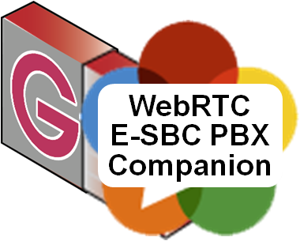
WebRTC Demo, Atlanta June 2013
Ingate’s SBCs do more than POTSoIP SIP. They were developed for standard compliant end-to-end multimedia SIP connectivity everywhere.
WebRTC is just aligned – Ingate adds Q-TURN telepresence quality and the WebRTC & SIP PBX Companion for the enterprise UC “social network”.
Merged Intertex Data AB and Ingate Systems AB
Karl Stahl CEO/CTO Ingate Systems info@ingate.com karl.stahl@intertex.se

Slide 2
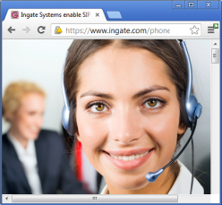
What is a “SIP Trunking E-SBC Vendor” Doing in the WebRTC Space?
Helping our PBX / UC friends with the “WebRTC & SIP PBX Companion” to get the benefits of WebRTC:
Click to Dial-In and pass Dial me-link
Browser based soft client, for local and remote enterprise UC users
Company
Web Server
media
WS
See that at Ingate’s Display Table 29
LAN
SIP

Slide 3
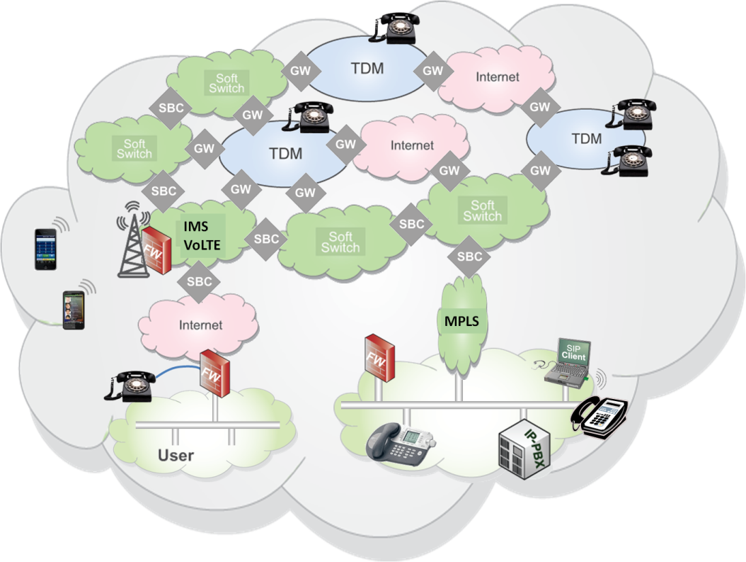
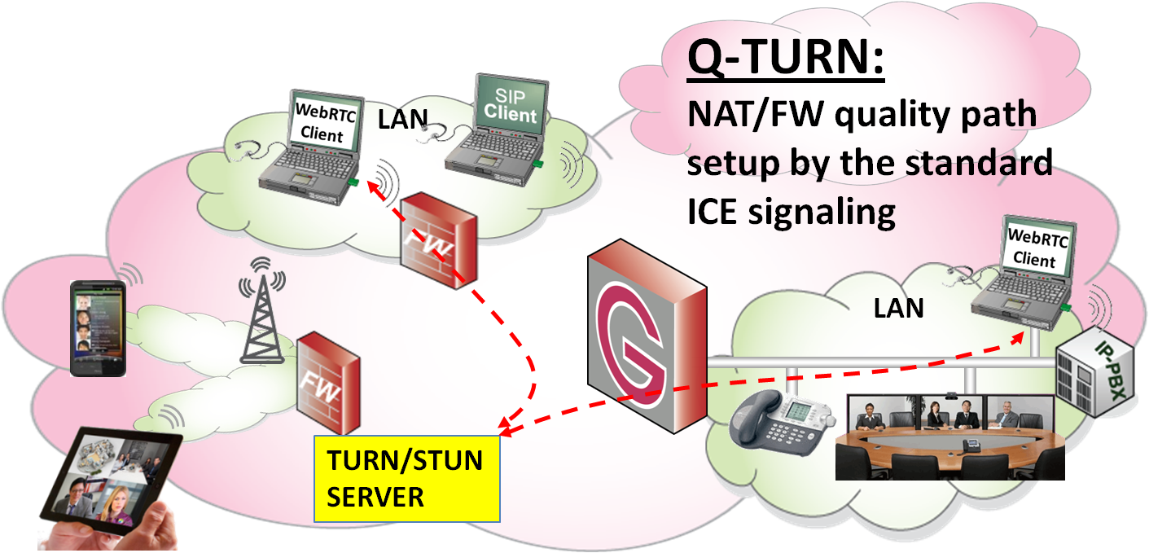
What is a “SIP Trunking E-SBC Vendor” Doing in the WebRTC Space?
Helping our PBX / UC friends with the “WebRTC & SIP PBX Companion” to get the benefits of WebRTC:
Click to Dial-In and pass Dial me-link
browser based soft client, for local and remote enterprise UC users
Introducing Q-TURN for the new real-time communication infrastructure that WebRTC brings:
The Internet for both best-effort and prioritized real-time traffic – Internet+
Prioritization and Traffic Shaping
Diffserve or RVSP QoS over the Internet
Authentication (in STUN and TURN)
Accounting – Payload Type is seen
RTC brought from POTSoIP islands to the Internet. What about Quality?
Today’s Demo
Q-TURN

Slide 4
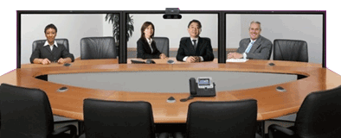
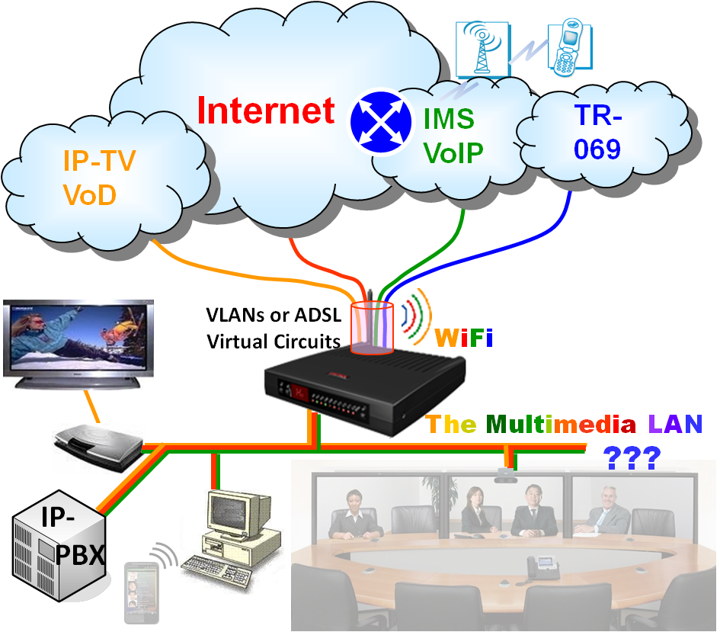
From POTS to Telepresence – A Gigantic Step
WebRTC has the potential of telepresence quality: Opus HiFi sound and VP8 / H.264 HD video
Layer 4 QoS: UDP over TCP is not sufficient
It is NOT “Just About Bandwidth”
Data crowded networks
Surf, email, file transfer fill the pipes
Carriers concerned – do advanced networks
But out comes RJ11 = POTS Quality…
Still, Internet has the largest bandwidth
We just need to Prioritize - Level 3 QoS
Pre- AM Radio
3,5 kHz to 20 kHz audio and 3,5 Mbps video
The Q-TURN Demo
RJ11

Slide 5
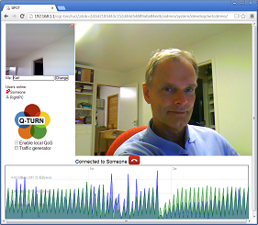
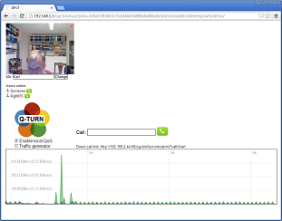
The Demo Setup at Table 29 – Sorry it’s not on this podium…
SNOM
Simulated Data Crowded Internet
10 Mbps old hub
ET4 for WAN
ET1-2 for SURF
ET3 for HUB
IX78
NET PC
192.168.2.42
192.168.2.1
Login admin; admin
Id 1 reregister
snom@192.168.2.44
192.168.2.44
Four iperf clients pushing through short TCP sessions
192.168.2.45
eth3
eth3
DEMO HERE
IXNX-1
IXNX-2
Ingate E-SBC Firewalls with Q-TURN & more
Also SIP registrar
for Snom phone
eth0
eth0
192.168.1.1
192.168.1.1
Dial snom
>System >Develop > WRTCdemo
Demo on LeftPC to show video
hacking without Q-TURN
192.168.1.10
192.168.1.10
iperf-server
http://192.168.1.1
4 x iperf-client
http://192.168.2.44:66
Open Windows Firewall for iperf
< 5 interfaces for Chrome bug

Slide 6
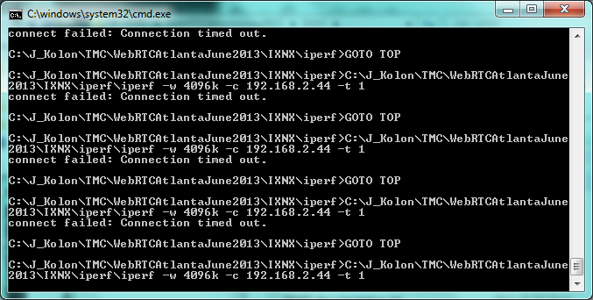
A Video Call Over a 10 Mbps Data Crowded Internet Access
Without QoS Q-TURN
DEMO
MOVIES
Simulated
Data Crowded Internet
10 Mbps old hub
With QoS Q-TURN
RTP media
Firewall with Q-TURN
4 short TCP traffic flows filling the pipe
http
RTP
4 iperf clients
TCP traffic

Slide 7
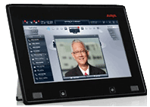
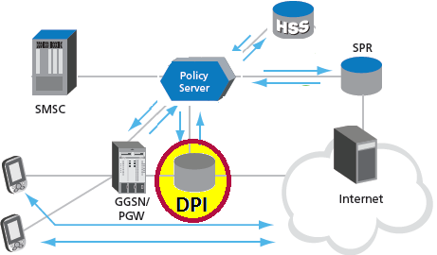
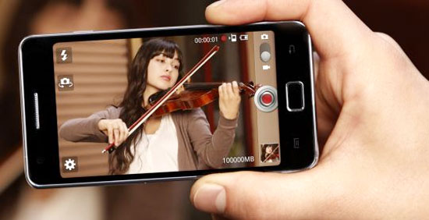
Major Implications of these waving: Q-TURN for Carrier Broadband Delivery
Sell a “WebRTC-Ready” Access!
Why only deliver Best Effort Data?
Quality Traffic - prioritized real-time traffic within the same pipe - is highly valuable, but cost no more bandwidth to produce!
OTT can be more
than data delivery.
Telepresence in
your pocket!
SIP Connect 1.1
Internet+
Q-TURN into the DPI and deliver real-time quality access OTT!

