Slide 1


Enabling WebRTC in the Enterprise
A) How Can WebRTC Enhance the PBX/UC Solution?
B) Will SIP Trunking E-SBCs Include WebRTC Support?
C) Can Carriers Provide a "WebRTC-Ready" Access?
Prepared for: Ingate SIP Trunk-UC Seminar
ITEXPO August 2013 Las Vegas
By: Karl Erik Ståhl
CEO Ingate Systems AB
(and Intertex Data AB, now merged)
karl.stahl@intertex.se
© 2013 Ingate Systems AB

Slide 2
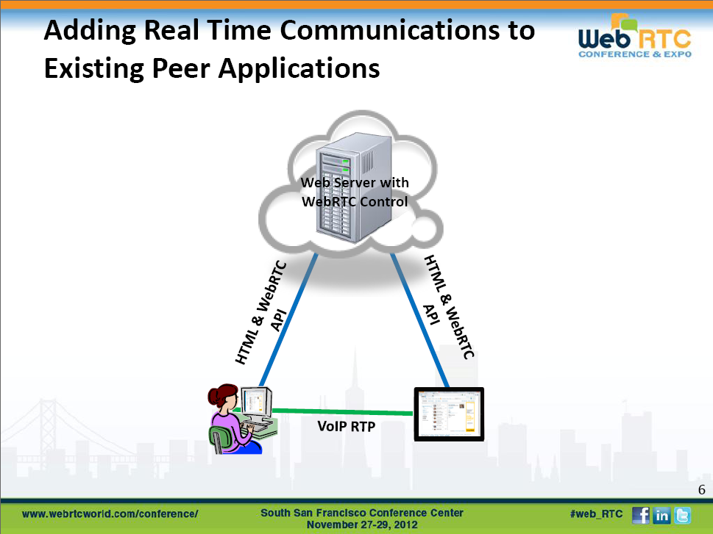
What WebRTC Does NOT Do:
“No Numbers” No rendezvous – “no addressing” at all. Not like SIP
------------
More islands? Yes, but it is adding high quality real-time communication where we already are in contact.
What WebRTC Does:
Sets up media directly between browsers (SDP/RTP like SIP) – typically on same web application.
“Handles” NAT/FW traversal (ICE, STUN, TURN) – fooling firewalls (like Skype).
Voice
Video
Data
“For free!”

Slide 3
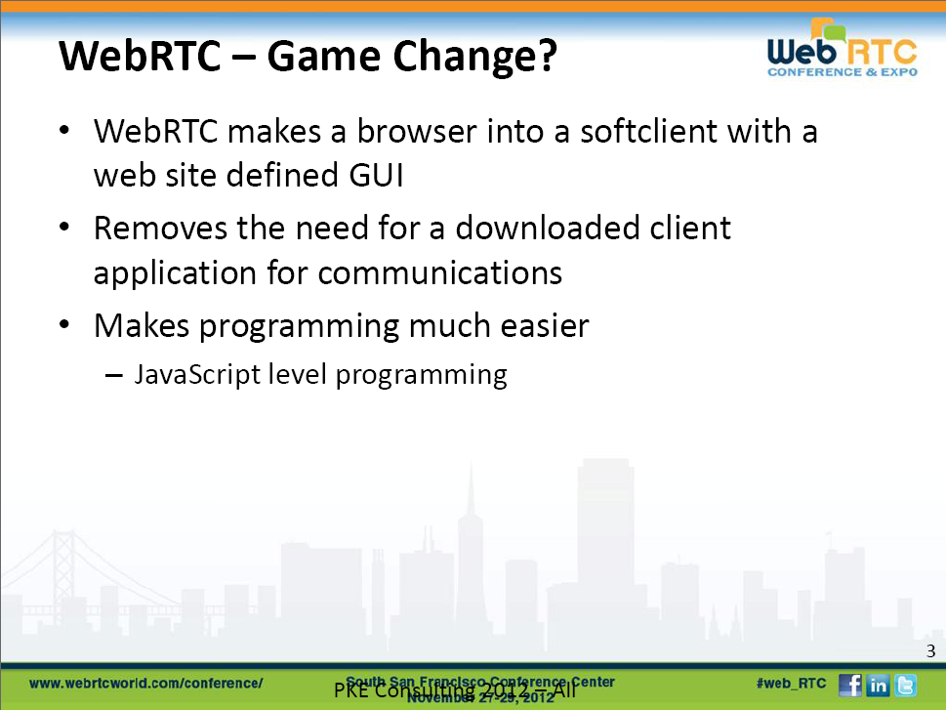
There is Power Behind – It Will Happen!
Google acquired GIPS (known from the Skype voice engine etc.) for 80 MUSD just to implement WebRTC in Chrome.
And another 130 MUSD for the VP8 licence free (H.264 like) video codec.
“Google recently released nearly $70M worth of open source code to the world…”
Intense standardization work (~a year to go):
IETF - the protocols
W3C - the Web application API (JS)

Slide 4
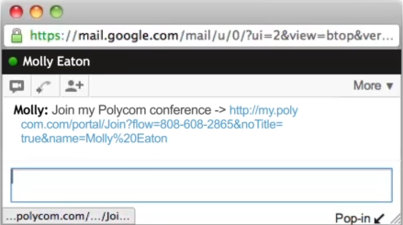
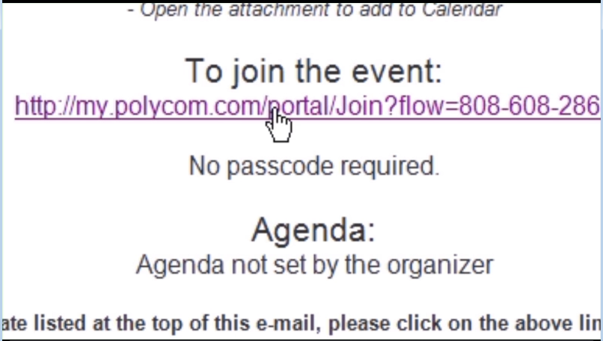
What is WebRTC? Social Calling…
Calling Without Phone Numbers
You already are in contact: Chatting, emailing. Just pass a URL to click!
Or join a scheduled meeting
No rendezvous protocol like SIP required
“Integrate into Facebook chat takes about half an hour”, Google says…
It is Internet/OTT and does not enter VoIP, IMS networks or the enterprise PBX, unless…

Slide 5



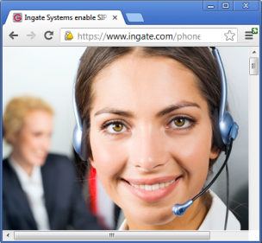

And a Click to Call Website is Great
Don’t Dial, Just click!
Calling by Clicking on Web Page
A Great Application
Need we more that the company website and the always available browser?
You are on the Web – Wanna talk?
– Don’t pick up your phone. Just click! Communicate with voice, video and data and screen.
Company
Web Server

Slide 6
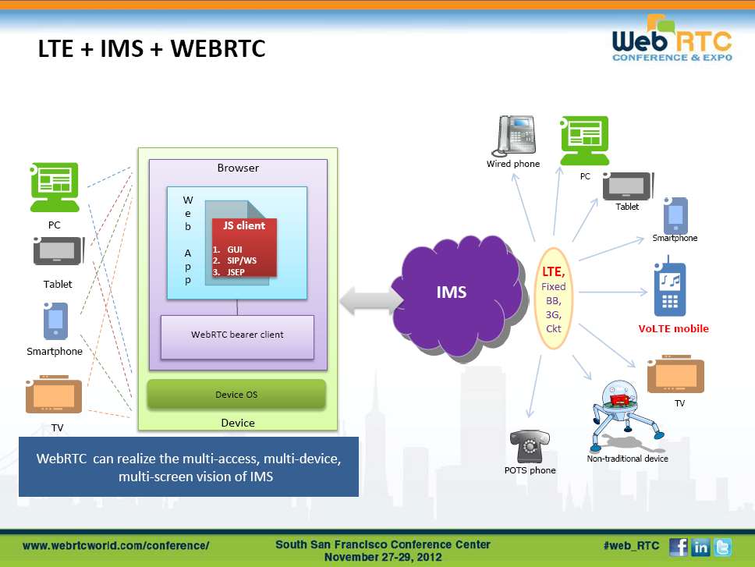
Finally a client for the IMS+RCS network!
The IMS view: “Now we can get an always available IMS-RCS client that hopefully resolves the NAT/ FW issue” (not as good as Skype and without QoS though…).
Yes, a Web application can be a softphone into e.g. an IMS+RCS network/ application

Slide 7


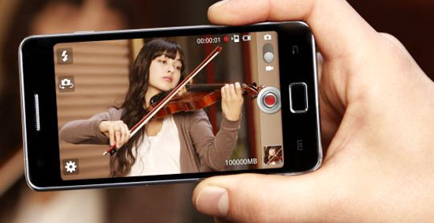
WebRTC and UC Require Better QoS Than Voice
* QoS discussion and details in footnote
C:WebRTCapplication.mp4
From 3.5 kHz Voice to HiFi HD Telepresence Quality!
Free Audio HiFi Codec Opus & Video HD Codec VP8 (H.264?)
* The confusion around Quality of Service (QoS) requirements for real-time traffic:
While telcos mostly regard QoS as highly important and often do level 2 or 2.5 separated networks or reservation type QoS, even where level 3 IP QoS (diffserve) could achieve the same, others (like “some IETF and WebRTC people” ) often ignore QoS, assuming such problems will go away and sometimes claim that “it is all about bandwidth”. That is true but only if the pipe not filled! However, TCP data traffic (surf, email, file transfer) intermittently fills the pipe, in its attempts to transfer that data as fast as possible. Doubling the bandwidth when sharing real-time traffic with intense data traffic on the same pipe, will not make half of the bandwidth usable for quality traffic - it will rather be half the time that the pipe is crowded.
Notes:
7

Slide 8
























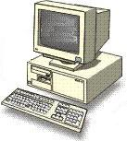

Can The Enterprise IP-PBX / UC Solution
“The Enterprise Social Network” Benefit From WebRTC?
SP’s SIP Trunking Connects to the POTS With its Numbers
What can/will WebRTC bring?
No numbers!
Browsers? – We are used to phones or softphones...
HD Multimedia – Telepresence ☺
Will WebRTC reach into the enterprise LAN?
SIP System
Internet
MPLS
SIParator®
Data & VoIP LAN

Slide 9







WebRTC Click to Call & …
Will WebRTC work through the enterprise LAN?
What about Quality? (Prioritization, Traffic shaping in the Firewall. Diffserve or RSVP for the network?) The Firewall is often the congestion point
There are remedies
… and much more
media
Company
Web Server
Company
Web Server
TURN SERVER
media
LAN
LAN
Q-TURN
Q-TURN

Slide 10


OK, Nice - But We Want Calls Into the Contac Center!
Our Auto Attendant, Queues, Forwards, Transfers, Conference Bridges, PBX Phones…
Is there “a Gateway” into the enterprise PBX / UC-solution?
Needed!
media
Company
Web Server
Company
Web Server
media
WS
LAN
LAN
SIP

Slide 11
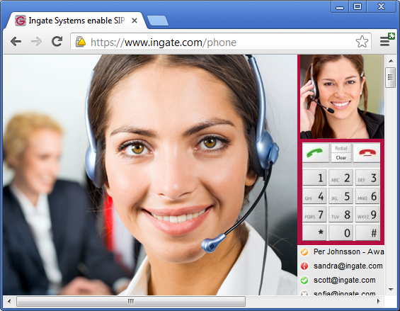
The WebRTC Browser as a Softphone
Having the PBX/UC Softphone available everywhere, on every device having a browser, without any plug-in and not just for plain voice phone calls, but potentially also for HiFi HD telepresence quality, is of course a dream.
This is the most obvious WebRTC application for the enterprise PBX or UC Solution.
It will especially ease remote PBX users because WebRTC includes a NAT/Firewall traversal method (ICE/STUN/TURN) in itself.

Slide 12
B) Will SIP Trunking E-SBCs
Include WebRTC Support?
There are two questions to address:
WebRTC into the enterprise (as it is)
WebRTC integrated with the PBX / UC-Solution Infrastructure
Prepared for: Ingate SIP Trunk-UC Seminar
ITEXPO August 2013 Las Vegas
By: Karl Erik Ståhl
CEO Ingate Systems AB
(and Intertex Data AB, now merged)
karl.stahl@intertex.se
© 2013 Ingate Systems AB

Slide 13

WebRTC Like All Real-Time Communication Protocols has a NAT/Firewall Traversal Problem
Firewalls do not allow unknown incoming traffic and media is a “surprise” (just like SIP)
SBCs are Firewalls that know SIP and take it into the LAN, but WebRTC prescribes ICE/STUN/TURN to fool the firewall to let the RTC traffic through (similar to Skype.)
Websockets, WS/WSS, often used to hold the signaling channel open
There are issues…
  Getting through
  Quality
signaling
media
media
Company
Web Server
Company
Web Server
STUN
TURN SERVER
WS/WSS
ICE
LAN
LAN

Slide 14
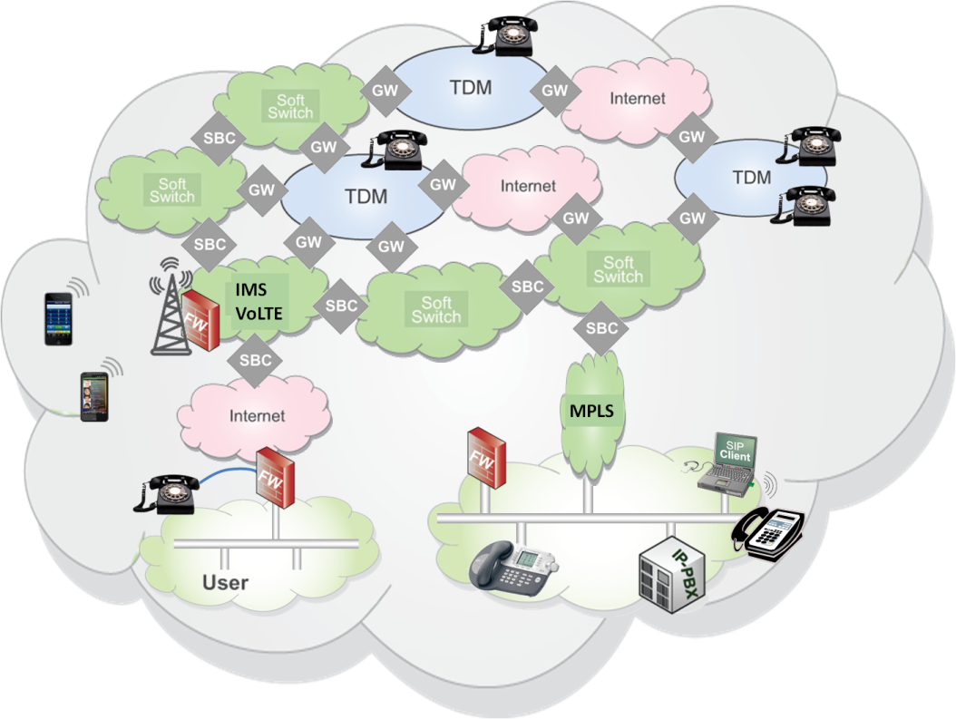
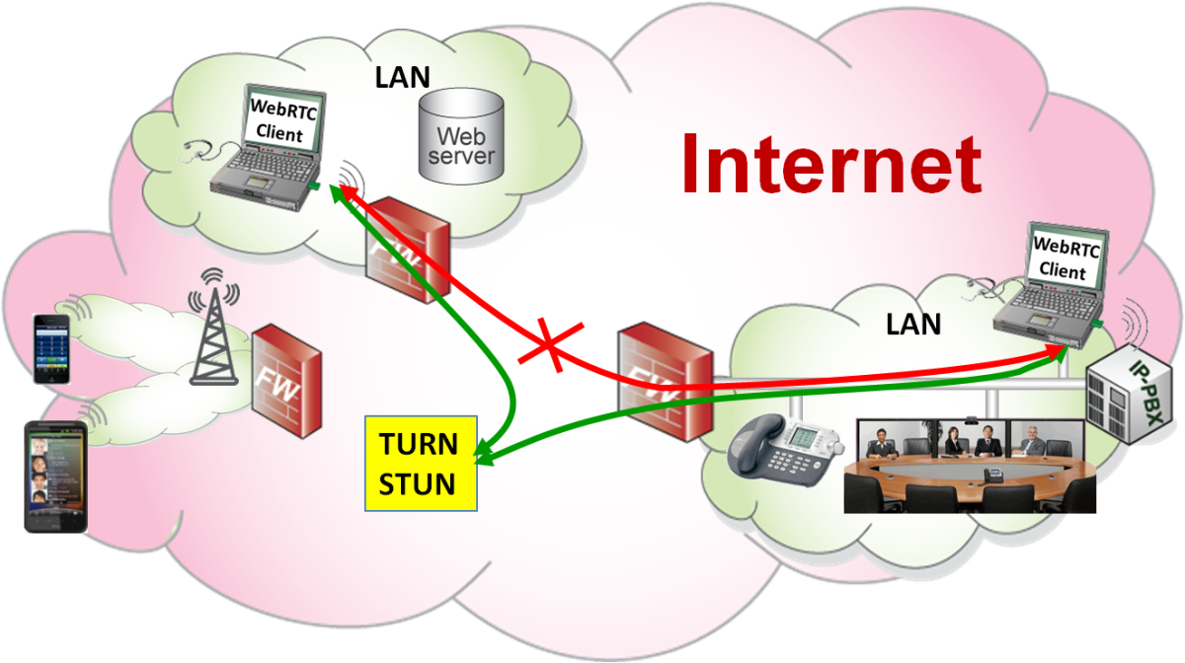
ICE/STUN/TURN Means There is no WebRTC-SBC
ICE was developed and standardized for SIP (long after SIP), but not used much for SIP… It is supposed to work without the Firewall being aware of what is traversed (like Skype).
Sometimes a TURN-server is required
With restrictive enterprise firewalls – ICE is not sufficient.
Best: WebRTC is end-to-end and does not encourage application specific networks
Worst: The firewalls are unaware of what is being traversed – Quality: The firewall cannot prioritize RTC traffic.

Slide 15
From POTS to Telepresence – A Gigantic Step
Pre- AM Radio 3.5 kHz voice to
20 kHz audio and 3.5 Mbps HD video
WebRTC has the potential of telepresence quality: Opus HiFi sound and VP8 / H.264 HD video
Layer 4 QoS: UDP over TCP is not sufficient
It is NOT “Just About Bandwidth”
  Data crowded networks
  Surf, email, file transfer fill the pipes
Still, Internet has the largest bandwidth
  We need to prioritize - Level 3 QoS

Slide 16
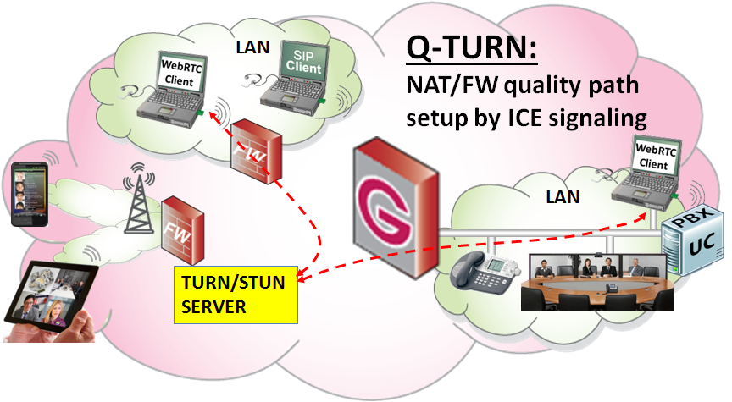
The TURN Server IN the Firewall Fixes Traversal, Quality and can Measure Usage: Q-TURN in the Firewall or an “EW-SBC”
A novel Ingate view:
Knock-knock; Give my media a Quality Pipe
Regard ICE as a request for real-time traffic through the Firewall. Interpret the STUN & TURN signals in the Firewall
Have the STUN/TURN server functionality IN the Firewall and setup the media flows under control
Security is back in the right place - The firewall is in charge of what is traversing
The Enterprise firewall can still be restrictive
Q-TURN
Q-TURN Enables QoS and More:
Prioritization and Traffic Shaping
Diffserve or RVSP QoS over the Net
Authentication (in STUN and TURN)
Accounting (usage of this pipe)

Slide 17
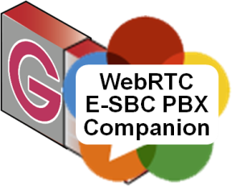
That was Getting WebRTC in Itself Into the LAN…
But, Where did the Enterprise PBX/UC Infrastructure go?
Enterprises have their own “Social Network” – their PBX / UC solution.
The E-SBC is already hooked the PBX SIP Trunking interface and often facing the Internet. A good place to put the “Gateway” in.
The E-SBC could include:
A WebRTC PBX Companion bringing the PBX/UC infrastructure back into WebRTC calls
media
Company
Web Server
Company
Web Server
media
WS
LAN
LAN
SIP

Slide 18

Same When Passing a Link
Want to be Reached at my Current PBX Phone!
You can also pass your WebRTC link over IM or an email and ask to click for calling you. http://companion.smartcomp.com/dialin.html?call=321@pbx.com
And the call should reach you via the SIP PBX/UC infrastructure with all its features.
Same
problem
Same
solution
An E-SBC could include:
A WebRTC PBX Companion bringing the PBX/UC infrastructure back into WebRTC calls
media
Company
Web Server
Company
Web Server
media
WS
LAN
LAN
SIP

Slide 19
The WebRTC Browser as a Softphone
Having the PBX/UC Softphone available everywhere, on every device having a browser, without any plug-in and not just for plain voice phone calls, but potentially also for HiFi HD telepresence quality, is of course a dream.
The E-SBC is usually hooked up to the LAN and the Internet – A good place to put the Softphone browser interface in.
An E-SBC could include:
A WebRTC PBX Companion allowing easy creation of browser based softphones for the PBX / UC solution.
The E-SBC facing the Internet and the NAT/Firewall traversal method (ICE/STUN/TURN) of WebRTC itself, will make remote user or mobility solutions “automatic”.

Slide 20
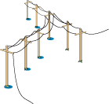
“Automatic Mobility” is a Major Feature
SIP Trunking Provider
SIP System
GW
PSTN
Remote User
Today, only the best E-SBCs support remote SIP clients and also do Far End NAT Traversal (FENT). And mobile operators’ mobility solutions requires a lot and gives few of the UC features.
SIParator®
IP-PBX
Data & VoIP LAN

Slide 21
Answer to:
Will SIP Trunking E-SBCs
Include WebRTC Support?
There seems to be two new product classes
The Q-TURN Firewall, and
The PBX/UC Companion
Both may end up in an “WE-SBC” – an E-SBC for both SIP and WebRTC – the location and interfaces of the SBC physical device is the same for SIP and WebRTC, at the enterprise edge, between the private enterprise LAN and the Global network (the Internet).
© 2013 Ingate Systems AB

Slide 22
C) Can Carriers Provide a
"WebRTC-Ready" Access?
Prepared for: Ingate SIP Trunk-UC Seminar
ITEXPO August 2013 Las Vegas
By: Karl Erik Ståhl
CEO Ingate Systems AB
(and Intertex Data AB, now merged)
karl.stahl@intertex.se
© 2013 Ingate Systems AB

Slide 23
From POTS to Telepresence – A Gigantic Step
Pre- AM Radio 3.5 kHz to 20 kHz audio and 3.5 Mbps video
WebRTC has the potential of telepresence quality: Opus HiFi sound and VP8 / H.264 HD video
And takes the real-time traffic to the Internet/OTT
It is NOT “Just About Bandwidth”
  The networks are data crowded
  Surf, email, file transfer fill the pipes
Layer 4 QoS: UDP over TCP is not sufficient
We need layer 3 QoS for high quality real-time traffic

Slide 24
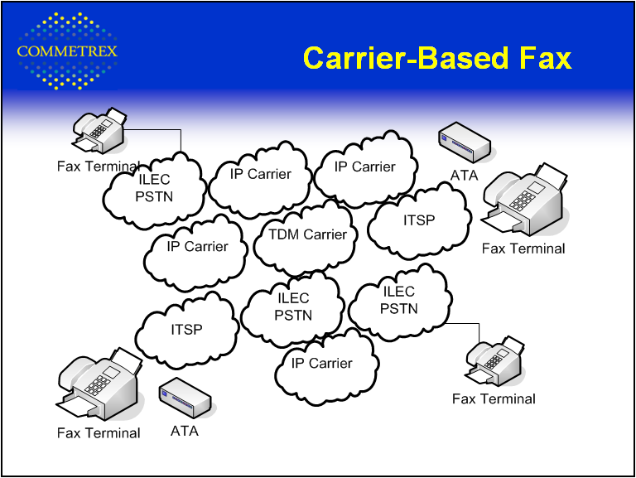
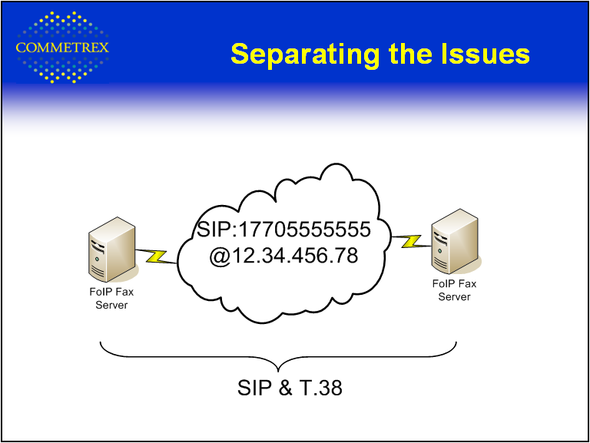
VoIP in the Application Specific Telephone Network has Not Helped – It isn’t Even Good for Faxing Anymore
Computers, Internet and related applications follow Moore’s law…
Telephony has over 20 years brought great mobility and popular text messaging (SMS)*, but otherwise showed a NEGATIVE Moore’s law (below)…
WebRTC is on the Internet, has to stay there, but needs quality!
The Telephony application is still only POTS, some day maybe RCS, but…
Carriers are Peering their IP-Network PSTN Style, degrading quality, interop…
It is even destructive for the 160 years old Fax service!**
And their billing is by voice minutes – Far away from any UC!
And where did the reliability, scalability and good performance of IP networks go?
** Mike Coffee, CEO of Commetrex: Work in progress by SIP Forum’s FoIP Task Group and the i3 Forum.
T.38 works fine in one hop!

Slide 25


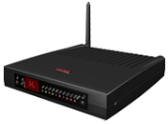
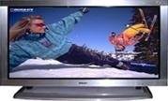

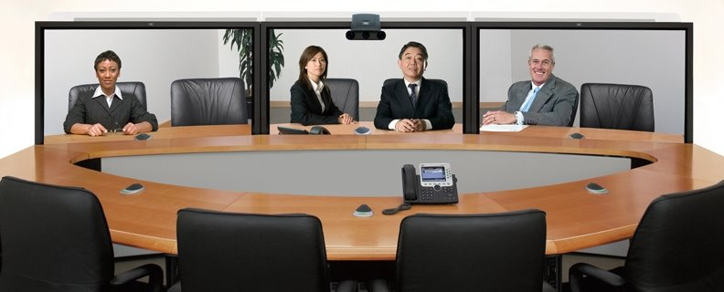

Locally, Carriers Have Since Long Provided Quality Traffic
Over the Broadband Connection (but Wasted it at the Delivery)
Internet
But we need the RTC on the LAN
– Not on an RJ11 = POTS
And today’s SIP trunking send the RTC into the POTSoIP structure – That is a PSTN-gateway. (SIP-devices could instead route to the other endpoint.)
IMS
VoIP
TR-069
IP-TV
VoD
RJ11
VLANs or ADSL Virtual Circuits
WiFi
The Multimedia LAN
Will prioritized traffic over the Internet cost more than best-effort traffic?
Telepresence

Slide 26
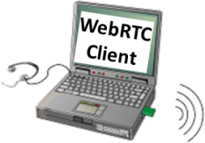

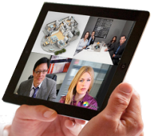
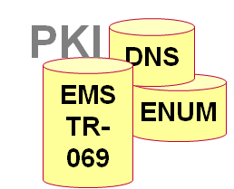






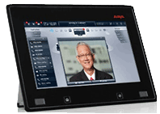

Quality Traffic on the Internet: The Internet⁺ Model
There are (disabled) quality mechanisms on the Internet – Enable and provide that quality to the users!
WebRTC is end-to-end. ICE/STUN/TURN is used through NAT/firewalls
There is no WebRTC proxy like in SIP that can classify, prioritize and measure calls. A TURN server at the delivery point can fill those needs: Q-TURN.
We need a “toll to enter the highway” or everyone will chose priority to surf faster – and we will be back to the same priority.
Real-time traffic is more valuable.
SIP Connect 1.1
Internet+
Notes:
Enabling quality on the Internet is quite easy, but meaningless if there is no “toll to enter the highway.”

Slide 27
The TURN Server IN the Firewall Fixes Traversal, Quality and can Measure: Q-TURN in the Firewall or an “EW-SBC”
A novel Ingate view:
Knock-knock; Give my media a Quality Pipe
Regard ICE as a request for real-time traffic through the Firewall. Interpret the STUN & TURN signals in the Firewall
Have the STUN/TURN server functionality IN the Firewall and setup the media flows under control
Security is back in the right place - The firewall is in charge of what is traversing
Enterprise firewall can still be restrictive
Q-TURN
Q-TURN Enables QoS and More:
Prioritization and Traffic Shaping
Diffserve or RVSP QoS over the Net
Authentication (in STUN and TURN)
Accounting (usage of this pipe)

Slide 28
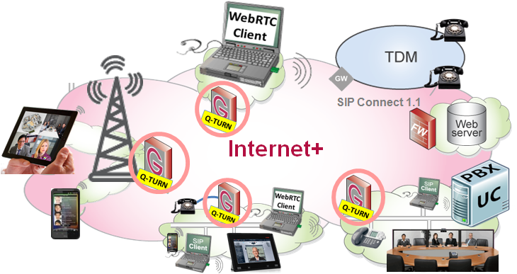
Q-TURN as the Carrier Broadband Delivery
Sell a “WebRTC-Ready” Access!
Why only deliver Best-Effort Data?
Quality Traffic - prioritized real-time traffic within the same pipe - is highly valuable, but cost no more bandwidth to produce!
OTT can be more than data delivery. Telepresence in
your pocket!
Q-TURN at the Carrier Demarcation Points
Mobile (replace the DPI behind the Cell Tower)
Enterprise and SMB delivery
Residential delivery – Fits embedded CPEs

Slide 29
A Healthy Win-Win Economy for Users and Carriers
E-SBCs with SIP proxies and TURN servers at the carrier demarcation point allow the already available bandwidth to be used for high quality real-time traffic delivery in addition to the best-effort data delivery.
The future loss of income from specific telephone networks , may be replaced by prioritized OTT and Internet traffic, charged separately from less valuable data traffic. The Internet+ model applies to fixed, Wi-Fi and mobile broadband delivery for both SIP and WebRTC traffic.
Decreasing Telephony Income Being Replaced by Real-Time Traffic over Data Crowed OTT and Internet Best Effort Traffic is a Lose-Lose Situation for Both Carriers and Users.
Delivering Prioritized, Separately Charged High Quality Multimedia Traffic Over Existing OTT and Internet Bandwidth, is a Win-Win Solution for Both Carriers and Users
Now
I
I
I
I
I
I
I
Low Charged
Internet Bandwidth
Bandwidth Usage
Data
Data
Limited Quality RTC
Quality ☺ Bandwidth
New Income
Skype etc.
RTC
SIP, WebRTC = Telephony⁺
Telephony Income (highly charged)
Notes:
29

