Slide 1
Broadvox Hosted Communications
SIP Trunking Academy
Ingate’s SIP Trunking-UC Seminars
IT Expo – Las Vegas
August 27, 2013

Slide 2
Why Offer a Hosted Solution
CUSTOMER BENEFITS
Reduce or eliminate capital expense
Level out operational costs
Avoid technological obsolesce
Reduced IT staff burden
Inherent support for teleworker
Business continuity
Disaster recover

Slide 3
Why Offer a Hosted Solution
PARTNER BENEFITS
Add telecom offering
Answer customer demand for “cloud solution”
Enterprise solution for SMB customer
Part of a total BC/DR solution
Larger broadband sales
Bigger monthly commission checks

Slide 4
How Important is Hosted UC?
50% of companies already use cloud services for key business applications source: Spiceworks
80% of companies allow employees to use their own devices / BYOD source: Aberdeen Research
Global IP Centrex market/($000)
40% growth year over year

Slide 5
Why Broadvox?
Our Roots
Delivering VoIP from the cloud since inception
No legacy network to migrate
Partner focused from day one
Our Network
Wholesale network serving over 400 carriers
Transports over 50 million minutes each day
Network of choice for IT industry leaders

Slide 6
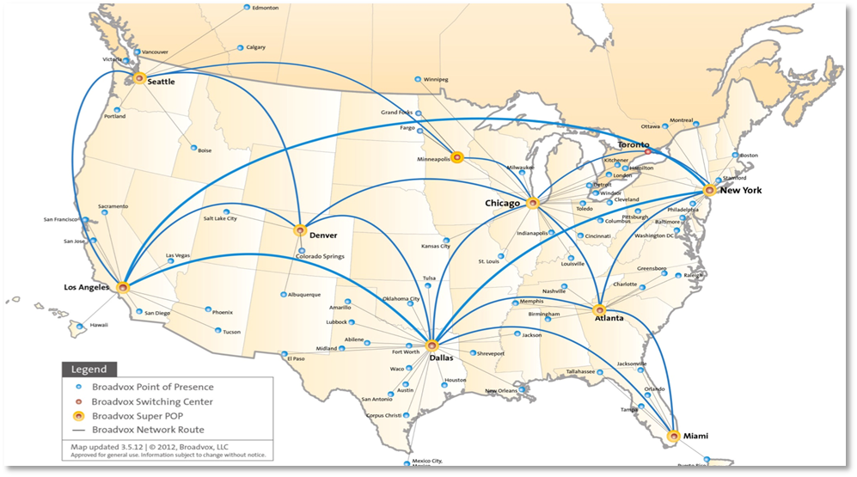
Why Broadvox?
Our Network
Major infrastructure enhancements in last 18 months
Sonus, BroadSoft, Acme, Cisco, Juniper

Slide 7
Why Broadvox?
Our Customers

Slide 8
Why Broadvox?
Our People
Extensive industry experience
Passion for customers
Leverage industry relationships
Our Partners
Over 4,000 partners trust Broadvox
Burning desire to see you succeed
Top down commitment to the channel

Slide 9
Why Broadvox?
Our promise
Help your customers succeed
Enable you from prospect to install
Be easy to do business with

Slide 10
What is Broadvox Hosted Unified Communications?
1
Telephony
IP phone
iOS/Android
PC / MAC
CLASS services
analog lines

Slide 11
What is Broadvox Hosted Unified Communications?
2
Messaging
1
Telephony
voicemail
IP phone
video mail
iOS/Android
vmail as email
PC / MAC
fax as email
CLASS services
vmail to text
analog lines

Slide 12
What is Broadvox Hosted Unified Communications?
2
Messaging
1
Telephony
voicemail
IP phone
video mail
iOS/Android
vmail as email
PC / MAC
fax as email
CLASS services
vmail to text
analog lines
IM
presence
video
audio conferencing
Web collaboration
3
Collaboration

Slide 13
What is Broadvox Hosted Unified Communications?
2
Messaging
1
Telephony
voicemail
IP phone
video mail
iOS/Android
vmail as email
PC / MAC
fax as email
CLASS services
4
cloud- hosted
delivered over IP
to any device
vmail to text
analog lines
IM
5
presence
video
audio conferencing
6
Web collaboration
3
Collaboration

Slide 14
Complete flexibility
Design your custom solution with your choice of:
Calling and Long Distance plans
Employee features
Company services
IP Phones
Network equipment
Broadband

Slide 15
The Right Calling Plan
Seat + Call Path Calling Plan
Seat Calling Plan
The business only pays for the number of call paths ordered
Call paths can be shared across all service locations
One simple flat rate per employee and phone
Each user can make and receive calls at any time
Concurrent calls only limited by available bandwidth at each location
One single calling plan per customer
Seat + Call Path pricing
easy comparison PRI/Trunk + PBX solution
Lower cost for higher seat count
Seat Pricing: flat fee per user per month
Both plans include low international rates

Slide 16
The Right Usage Plan
Unlimited Local
Unlimited Long Distance
Unlimited inbound and outbound local calling
Domestic long distance calls: $0.021/min
Option: add Long Distance bundle to reduce rate / min
Includes unlimited inbound and outbound calling to Lower 48, Canada, Hawaii and Puerto Rico
One single usage plan per customer
Unlimited long distance: simple, predictable monthly bill
Unlimited local: only pay for the long distance used

Slide 17
Feature Sets
Common Area Seat
DID
Basic calling services
HD Voice
Video calling

Slide 18
Feature Sets
Hosted Voice Seat
Common Area Seat
Unified messaging
Instant conferencing
Advanced call routing
Fixed Mobile convergence
Find Me / Follow Me
DID
Basic calling services
HD Voice
Video calling
Note: Receptionist software client optional on Hosted Voice and Hosted UC seats

Slide 19
Feature Sets
Hosted UC Seat
Instant messaging
Presence
Personal audio bridge
Voicemail to text
Instant desktop sharing
Web Collaboration
Fax Messaging
3rd Party Apps integration
Broadvox Communicator client
Voice and Video Calling
Instant Messaging
Enhanced Presence
Instant Desktop Sharing
Hosted Voice Seat
Common Area Seat
Unified messaging
Instant conferencing
Advanced call routing
Fixed Mobile convergence
Find Me / Follow Me
DID
Basic calling services
HD Voice
Video calling
Note: Receptionist software client optional on Hosted Voice and Hosted UC seats

Slide 20
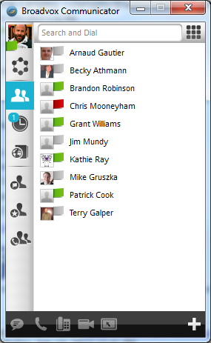
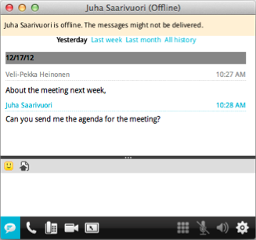
Hosted UC Feature: Broadvox Communicator
Software application enables:
Viewing co-worker presence
Instant Messaging
Voice and Video Calling
Desktop Sharing
Voice Feature Configuration
Unified Communications experience across mobile and desktop
Supported Platforms:
Windows
Mac
iOS
Android
Included with every Hosted UC Seat.
Copyright © 2001-2013 BROADVOX LLC.
20

Slide 21
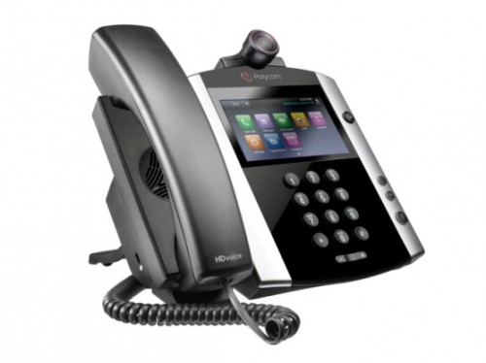
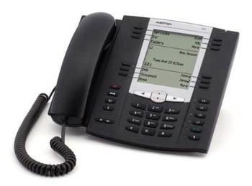
Phone Handsets
Recommended handsets
Covers most use cases
Fully certified for use with platform
Automated provisioning / configuration
Firmware support / upgrades
Best experience (UI, voice quality)
Purchase or rental, warranty
Professional installation
Additional Certified handsets
Fully certified for basic use with platform
Automated provisioning / configuration
Minimum firmware revision required
Partner or customer fulfillment, warranty
Additional partner validation recommended

Slide 22
Technician Installation Certification
Generate additional revenue
Control the on-site customer experience
Combine Hosted UC with other LAN upgrades
Next steps:
Execute amendment to partner agreement (Installation)
Pass Installation Certification test (individual technician certification)
Order services with partner-provided installation

Slide 23
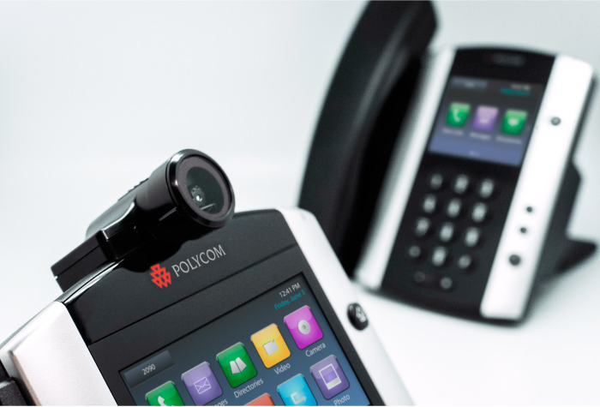
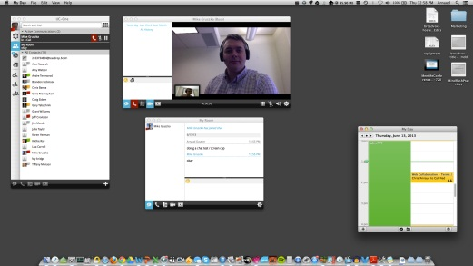
Broadvox Hosted Communications
HD Voice | Video | Instant Messaging | Conferencing
Web Collaboration | Mobility | Voice Mail

